Slide 1
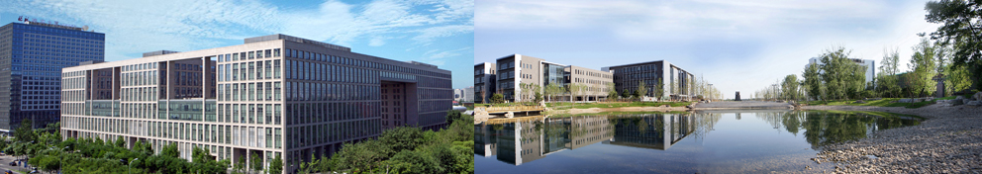
Design and Analysis of Algorithms
Part I: Divide and Conquer
Lecture 4: The Polynomial Multiplication Problem
and Quicksort Problem
Ke Xu and Yongxin Tong
(许可 与 童咏昕)
School of CSE, Beihang University

Slide 2
Outline
Review to Divide-and-Conquer Paradigm
Polynomial Multiplication Problem
Problem definition
A brute force algorithm
A first divide-and-conquer algorithm
An improved divide-and-conquer algorithm
Analysis of the divide-and-conquer algorithm
Quicksort Problem
Basic partition
Randomized partition and randomized quicksort
Analysis of the randomized quicksort

Slide 3
Outline
Review to Divide-and-Conquer Paradigm
Polynomial Multiplication Problem
Problem definition
A brute force algorithm
A first divide-and-conquer algorithm
An improved divide-and-conquer algorithm
Analysis of the divide-and-conquer algorithm
Quicksort Problem
Basic partition
Randomized partition and randomized quicksort
Analysis of the randomized quicksort

Slide 4
Review to Divide-and-Conquer Paradigm
Divide-and-conquer (D&C) is an important algorithm design paradigm.
Divide Dividing a given problem into two or more subproblems (ideally of approximately equal size)
Conquer Solving each subproblem (directly if small enough or recursively)
Combine Combining the solutions of the subproblems into a global solution

Slide 5
Review to Divide-and-Conquer Paradigm
In Part I, we will illustrate Divide-and-Conquer using several examples:
Maximum Contiguous Subarray (最大子数组)
Counting Inversions (逆序计数)
Polynomial Multiplication (多项式乘法)
QuickSort and Partition (快速排序与划分)
Lower Bound for Sorting (基于比较的排序下界)

Slide 6
Review to Divide-and-Conquer Paradigm
In Part I, we will illustrate Divide-and-Conquer using several examples:
Maximum Contiguous Subarray (最大子数组)
Counting Inversions (逆序计数)
Polynomial Multiplication (多项式乘法)
QuickSort and Partition (快速排序与划分)
Lower Bound for Sorting (基于比较的排序下界)

Slide 7
Outline
Review to Divide-and-Conquer Paradigm
Polynomial Multiplication Problem
Problem definition
A brute force algorithm
A first divide-and-conquer algorithm
An improved divide-and-conquer algorithm
Analysis of the divide-and-conquer algorithm
Quicksort Problem
Basic partition
Randomized partition and randomized quicksort
Analysis of the randomized quicksort

Slide 8
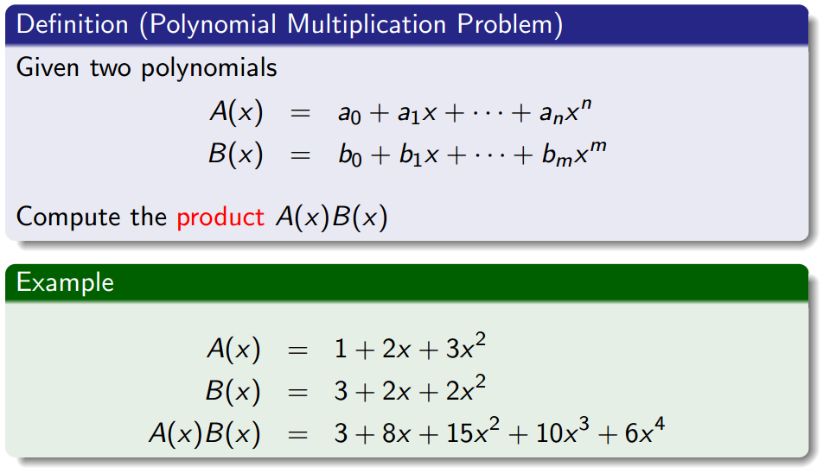
The Polynomial Multiplication Problem

Slide 9
The Polynomial Multiplication Problem

Slide 10
The Polynomial Multiplication Problem
Assume that the coefficients a_{i} and b_{i} are stored in arrays A[0…n] and B[0…m]

Slide 11
The Polynomial Multiplication Problem
Assume that the coefficients a_{i} and b_{i} are stored in arrays A[0…n] and B[0…m]
Cost: number of scalar multiplications and additions

Slide 12
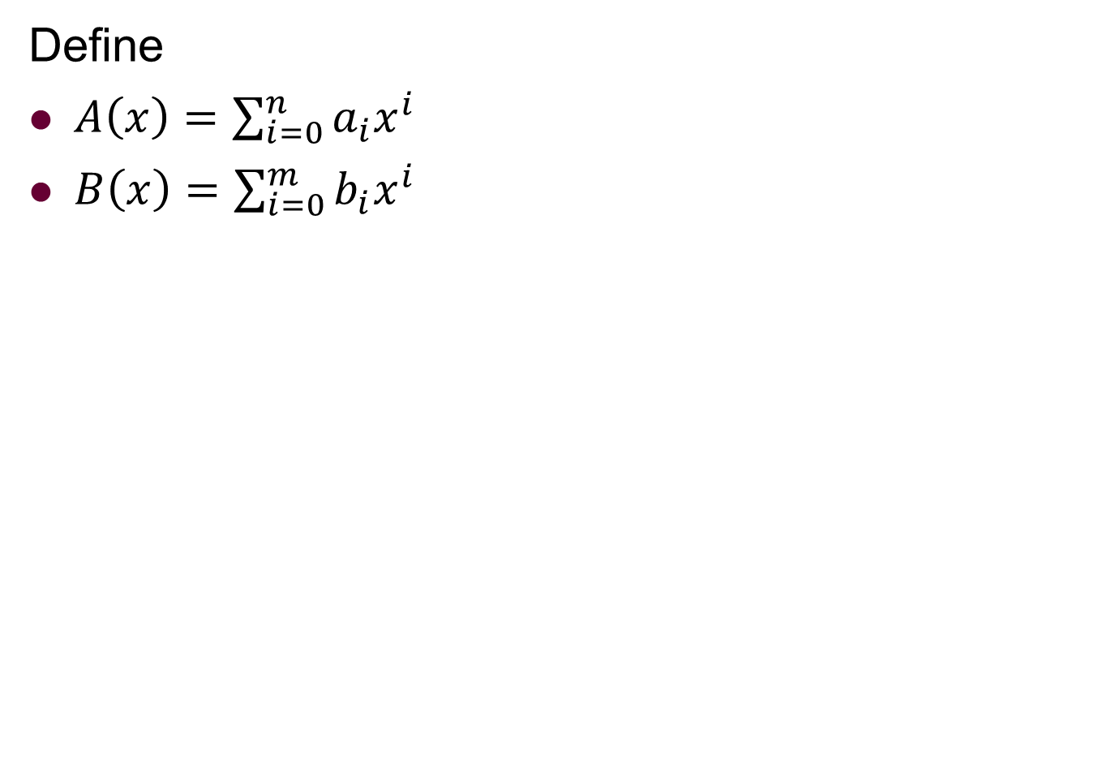
What do we need to compute exactly?
Define
$A\left(x\right)=\sum_{i=0}^{n}{a_{i}x^{i}}$
$B\left(x\right)=\sum_{i=0}^{m}{b_{i}x^{i}}$

Slide 13
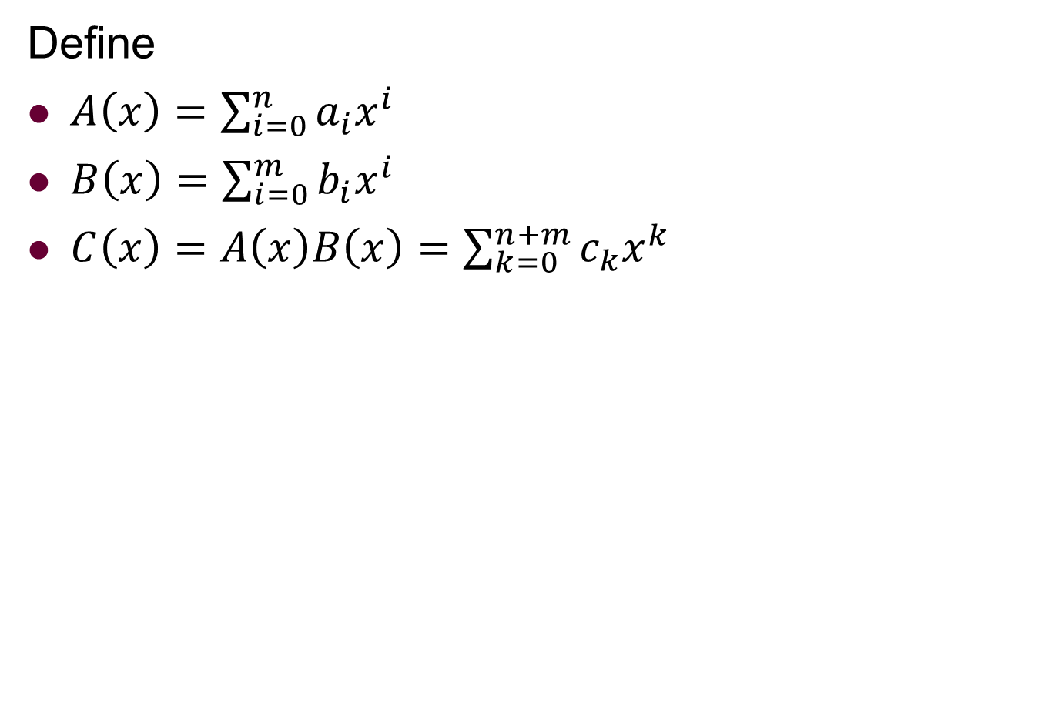
What do we need to compute exactly?
Define
$A\left(x\right)=\sum_{i=0}^{n}{a_{i}x^{i}}$
$B\left(x\right)=\sum_{i=0}^{m}{b_{i}x^{i}}$
$C\left(x\right)=A\left(x\right)B\left(x\right)=\sum_{k=0}^{n+m}{c_{k}x^{k}}$

Slide 14
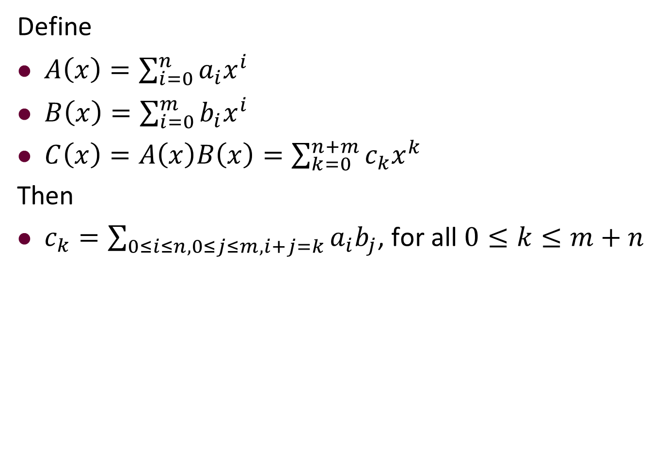
What do we need to compute exactly?
Define
$A\left(x\right)=\sum_{i=0}^{n}{a_{i}x^{i}}$
$B\left(x\right)=\sum_{i=0}^{m}{b_{i}x^{i}}$
$C\left(x\right)=A\left(x\right)B\left(x\right)=\sum_{k=0}^{n+m}{c_{k}x^{k}}$
Then
$c_{k}=\sum_{0≤i≤n,0≤j≤m,i+j=k}{a_{i}b_{j}}$, for all $0≤k≤m+n$

Slide 15
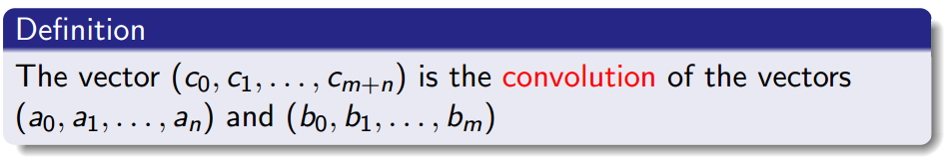
What do we need to compute exactly?
Define
$A\left(x\right)=\sum_{i=0}^{n}{a_{i}x^{i}}$
$B\left(x\right)=\sum_{i=0}^{m}{b_{i}x^{i}}$
$C\left(x\right)=A\left(x\right)B\left(x\right)=\sum_{k=0}^{n+m}{c_{k}x^{k}}$
Then
$c_{k}=\sum_{0≤i≤n,0≤j≤m,i+j=k}{a_{i}b_{j}}$, for all $0≤k≤m+n$

Slide 16
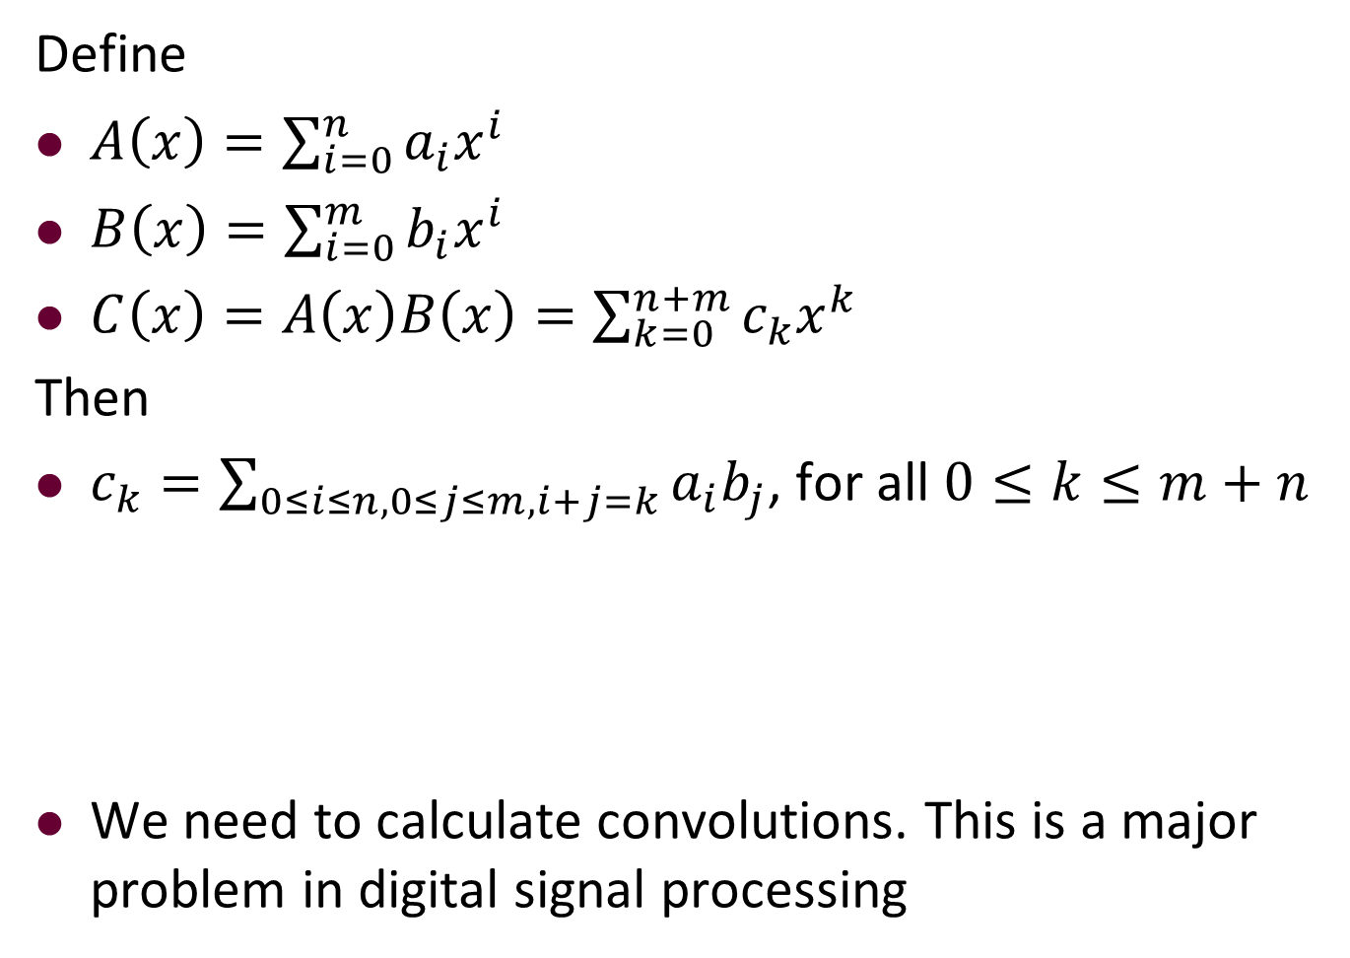
What do we need to compute exactly?
Define
$A\left(x\right)=\sum_{i=0}^{n}{a_{i}x^{i}}$
$B\left(x\right)=\sum_{i=0}^{m}{b_{i}x^{i}}$
$C\left(x\right)=A\left(x\right)B\left(x\right)=\sum_{k=0}^{n+m}{c_{k}x^{k}}$
Then
$c_{k}=\sum_{0≤i≤n,0≤j≤m,i+j=k}{a_{i}b_{j}}$, for all $0≤k≤m+n$
We need to calculate convolutions. This is a major problem in digital signal processing

Slide 17
Outline
Review to Divide-and-Conquer Paradigm
Polynomial Multiplication Problem
Problem definition
A brute force algorithm
A first divide-and-conquer algorithm
An improved divide-and-conquer algorithm
Analysis of the divide-and-conquer algorithm
Quicksort Problem
Basic partition
Randomized partition and randomized quicksort
Analysis of the randomized quicksort

Slide 18
Direct (Brute Force) Approach
To ease analysis, assume n = m.

Slide 19
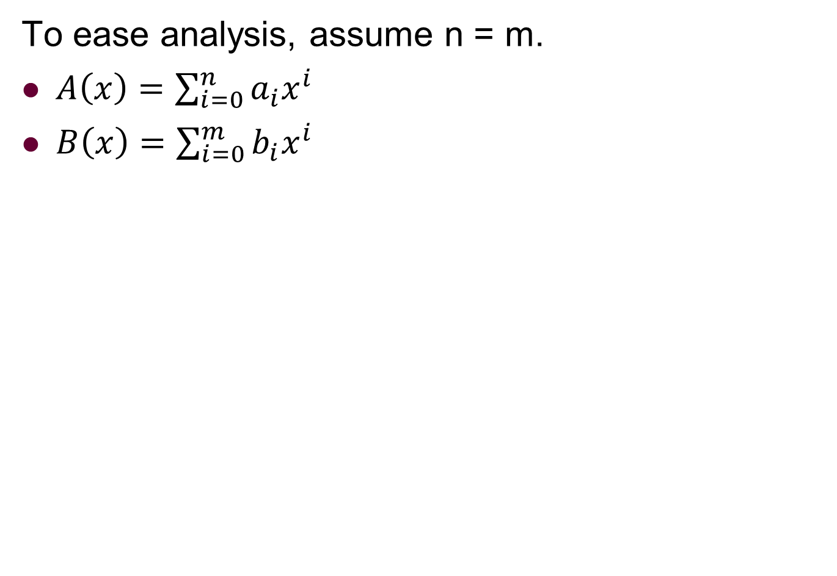
Direct (Brute Force) Approach
To ease analysis, assume n = m.
$A\left(x\right)=\sum_{i=0}^{n}{a_{i}x^{i}}$
$B\left(x\right)=\sum_{i=0}^{m}{b_{i}x^{i}}$

Slide 20
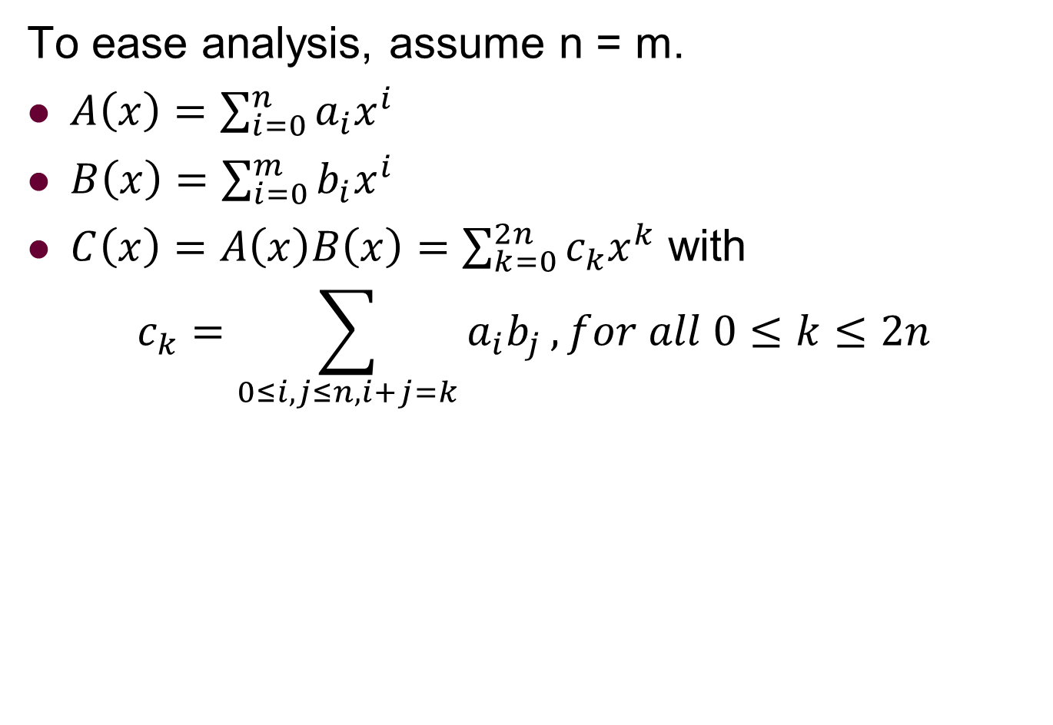
Direct (Brute Force) Approach
To ease analysis, assume n = m.
$A\left(x\right)=\sum_{i=0}^{n}{a_{i}x^{i}}$
$B\left(x\right)=\sum_{i=0}^{m}{b_{i}x^{i}}$
$C\left(x\right)=A\left(x\right)B\left(x\right)=\sum_{k=0}^{2n}{c_{k}x^{k}}$ with
$$c_{k}=\sum_{0≤i,j≤n,i+j=k}{a_{i}b_{j}}, for all 0≤k≤2n$$

Slide 21
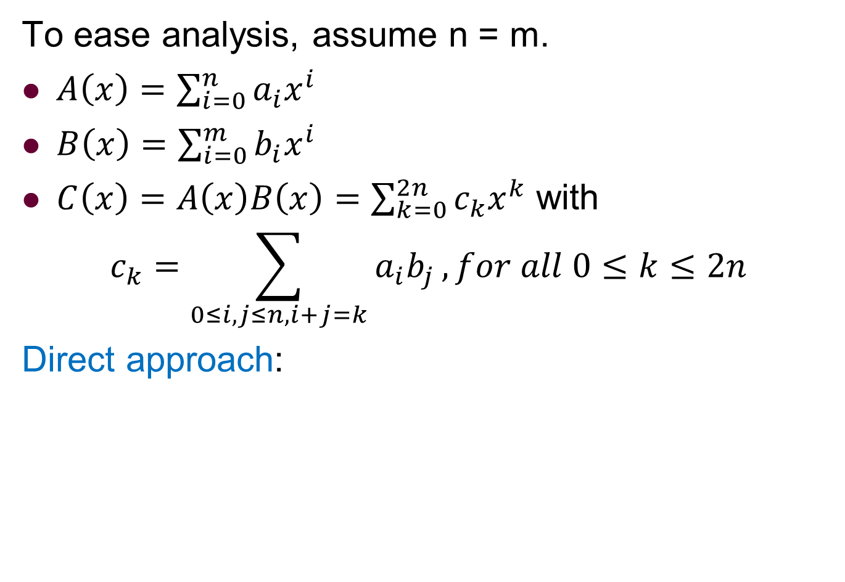
Direct (Brute Force) Approach
To ease analysis, assume n = m.
$A\left(x\right)=\sum_{i=0}^{n}{a_{i}x^{i}}$
$B\left(x\right)=\sum_{i=0}^{m}{b_{i}x^{i}}$
$C\left(x\right)=A\left(x\right)B\left(x\right)=\sum_{k=0}^{2n}{c_{k}x^{k}}$ with
$$c_{k}=\sum_{0≤i,j≤n,i+j=k}{a_{i}b_{j}}, for all 0≤k≤2n$$
Direct approach:

Slide 22
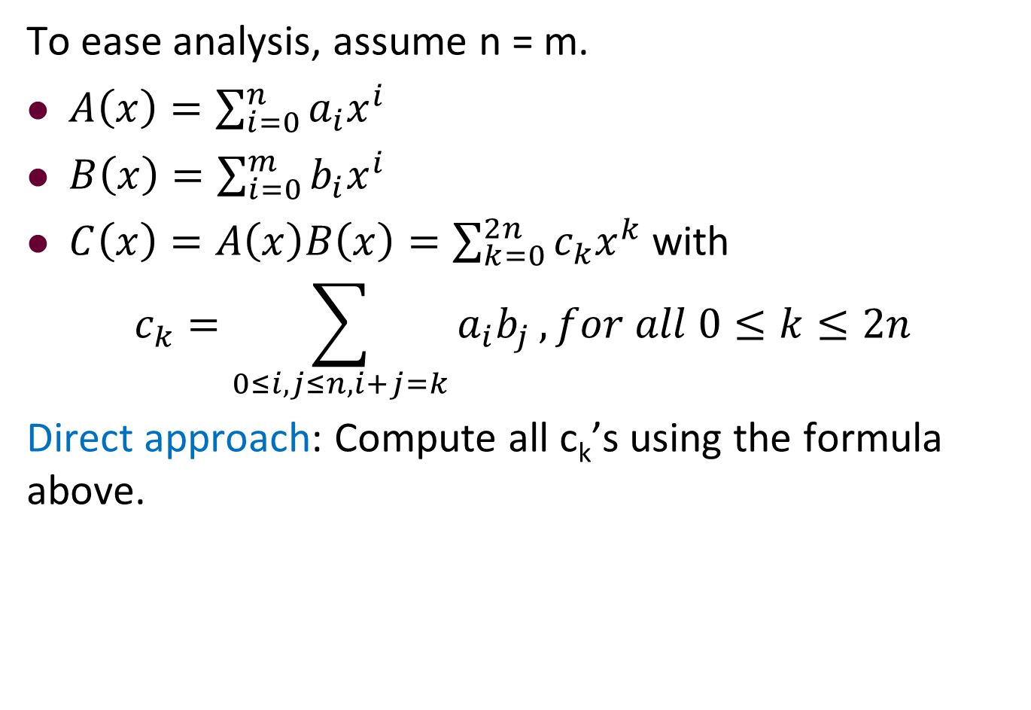
Direct (Brute Force) Approach
To ease analysis, assume n = m.
$A\left(x\right)=\sum_{i=0}^{n}{a_{i}x^{i}}$
$B\left(x\right)=\sum_{i=0}^{m}{b_{i}x^{i}}$
$C\left(x\right)=A\left(x\right)B\left(x\right)=\sum_{k=0}^{2n}{c_{k}x^{k}}$ with
$$c_{k}=\sum_{0≤i,j≤n,i+j=k}{a_{i}b_{j}}, for all 0≤k≤2n$$
Direct approach: Compute all c_{k}’s using the formula above.

Slide 23
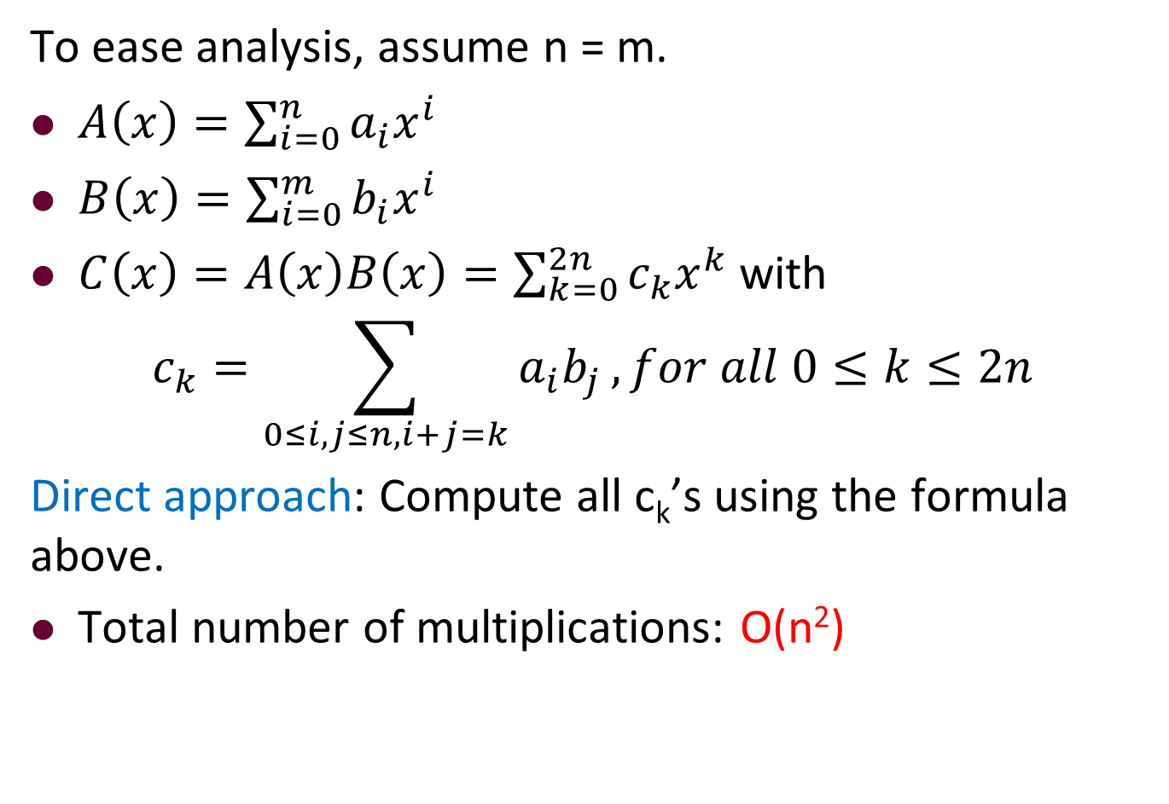
Direct (Brute Force) Approach
To ease analysis, assume n = m.
$A\left(x\right)=\sum_{i=0}^{n}{a_{i}x^{i}}$
$B\left(x\right)=\sum_{i=0}^{m}{b_{i}x^{i}}$
$C\left(x\right)=A\left(x\right)B\left(x\right)=\sum_{k=0}^{2n}{c_{k}x^{k}}$ with
$$c_{k}=\sum_{0≤i,j≤n,i+j=k}{a_{i}b_{j}}, for all 0≤k≤2n$$
Direct approach: Compute all c_{k}’s using the formula above.
Total number of multiplications: O(n²)

Slide 24
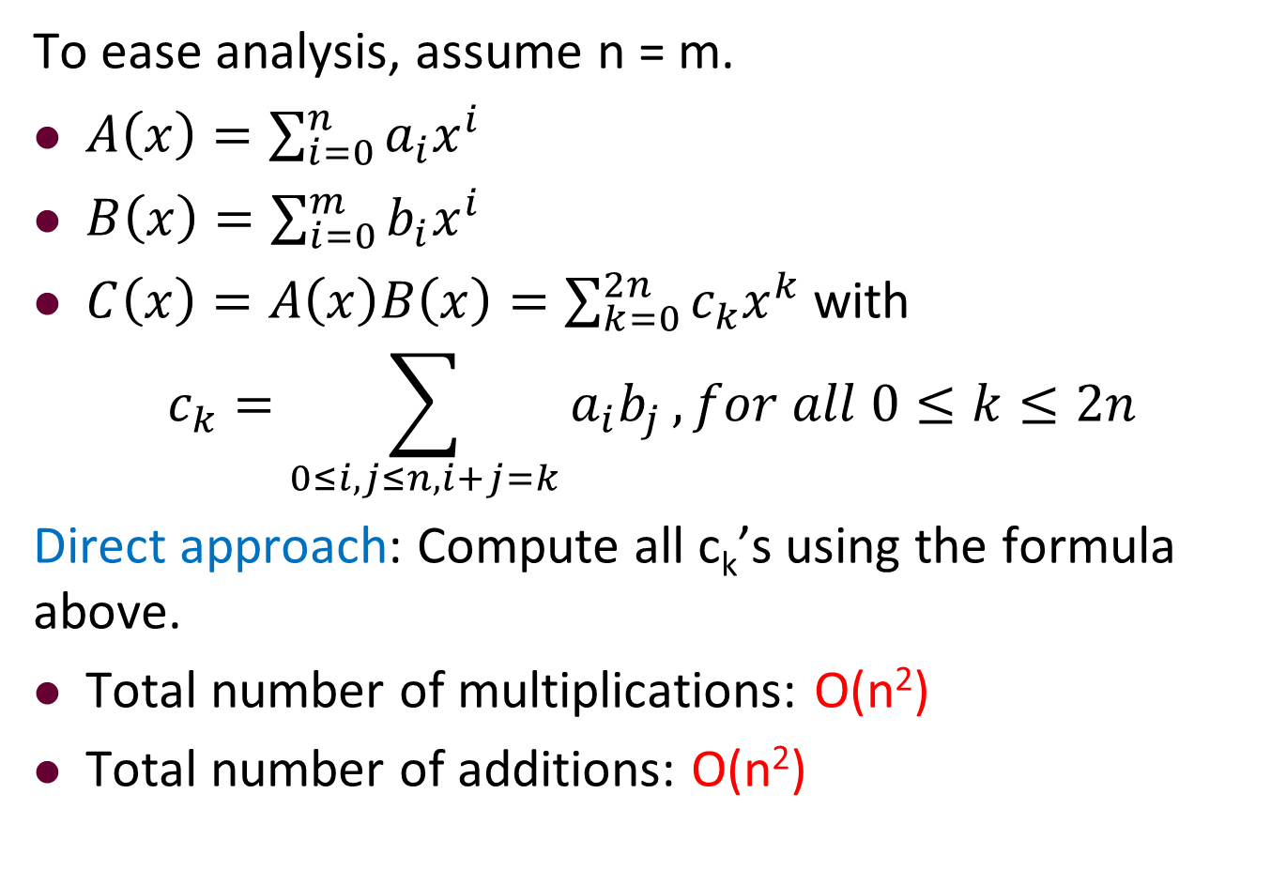
Direct (Brute Force) Approach
To ease analysis, assume n = m.
$A\left(x\right)=\sum_{i=0}^{n}{a_{i}x^{i}}$
$B\left(x\right)=\sum_{i=0}^{m}{b_{i}x^{i}}$
$C\left(x\right)=A\left(x\right)B\left(x\right)=\sum_{k=0}^{2n}{c_{k}x^{k}}$ with
$$c_{k}=\sum_{0≤i,j≤n,i+j=k}{a_{i}b_{j}}, for all 0≤k≤2n$$
Direct approach: Compute all c_{k}’s using the formula above.
Total number of multiplications: O(n²)
Total number of additions: O(n²)

Slide 25
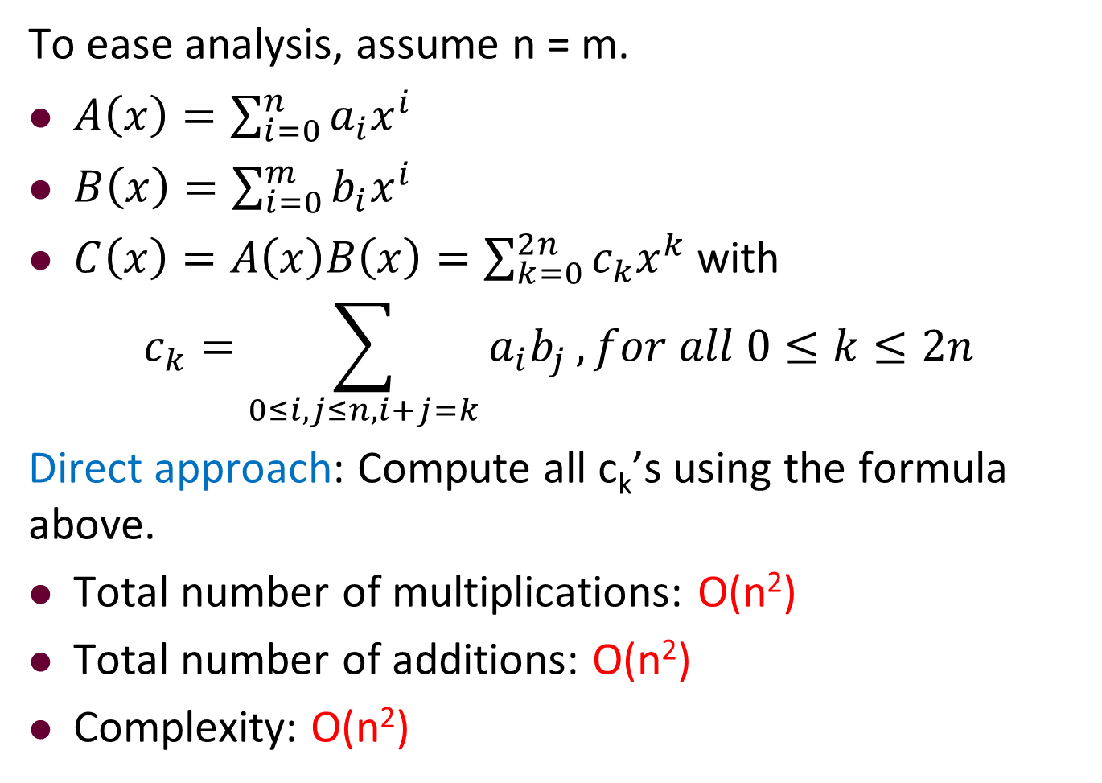
Direct (Brute Force) Approach
To ease analysis, assume n = m.
$A\left(x\right)=\sum_{i=0}^{n}{a_{i}x^{i}}$
$B\left(x\right)=\sum_{i=0}^{m}{b_{i}x^{i}}$
$C\left(x\right)=A\left(x\right)B\left(x\right)=\sum_{k=0}^{2n}{c_{k}x^{k}}$ with
$$c_{k}=\sum_{0≤i,j≤n,i+j=k}{a_{i}b_{j}}, for all 0≤k≤2n$$
Direct approach: Compute all c_{k}’s using the formula above.
Total number of multiplications: O(n²)
Total number of additions: O(n²)
Complexity: O(n²)

Slide 26
Outline
Review to Divide-and-Conquer Paradigm
Polynomial Multiplication Problem
Problem definition
A brute force algorithm
A first divide-and-conquer algorithm
An improved divide-and-conquer algorithm
Analysis of the divide-and-conquer algorithm
Quicksort Problem
Basic partition
Randomized partition and randomized quicksort
Analysis of the randomized quicksort

Slide 27
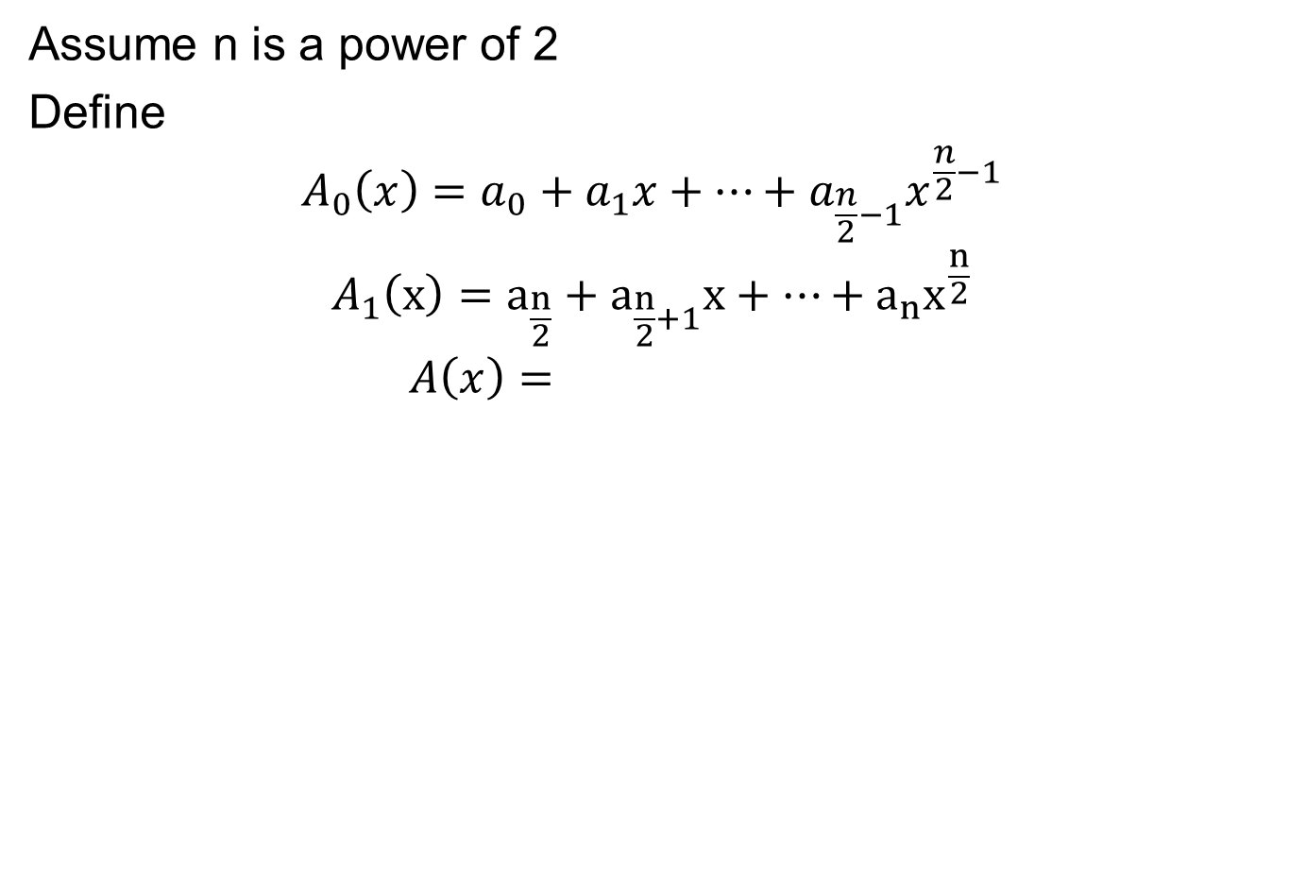
The First Divide-and-Conquer: Divide
Assume n is a power of 2
Define
$$A_{0}\left(x\right)=a_{0}+a_{1}x+…+a_{\frac{n}{2}−1}x^{\frac{n}{2}−1}$$
$$A_{1}（x）=a_{\frac{n}{2}}+a_{\frac{n}{2}+1}x+…+a_{n}x^{\frac{n}{2}}$$
$$A\left(x\right)=$$

Slide 28
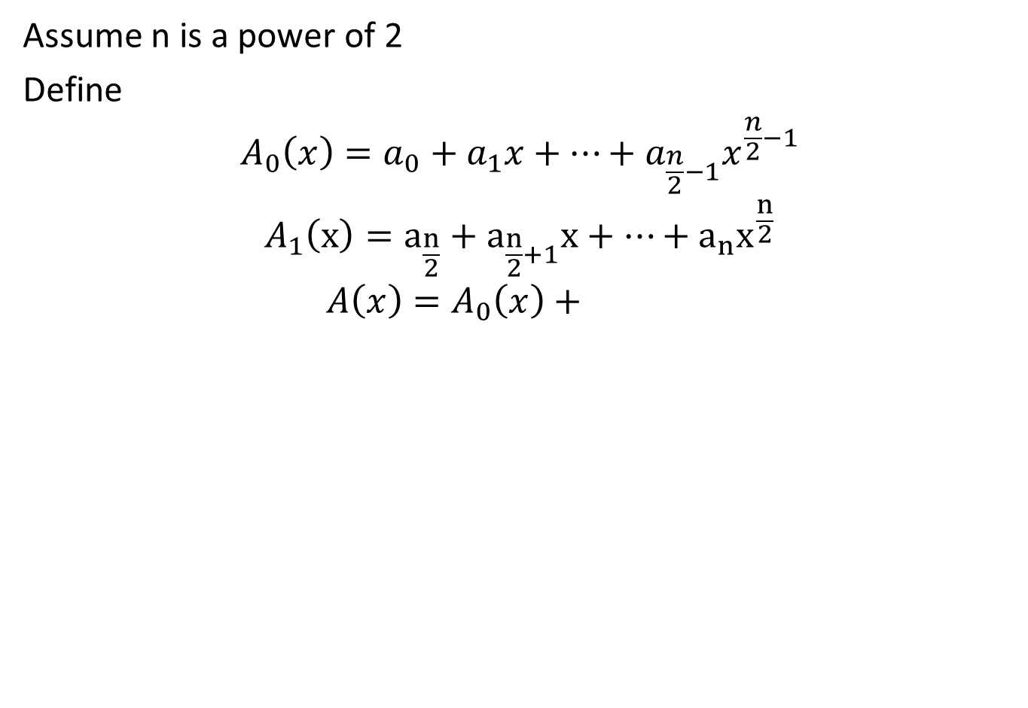
The First Divide-and-Conquer: Divide
Assume n is a power of 2
Define
$$A_{0}\left(x\right)=a_{0}+a_{1}x+…+a_{\frac{n}{2}−1}x^{\frac{n}{2}−1}$$
$$A_{1}（x）=a_{\frac{n}{2}}+a_{\frac{n}{2}+1}x+…+a_{n}x^{\frac{n}{2}}$$
$$A\left(x\right)=A_{0}\left(x\right)+$$

Slide 29
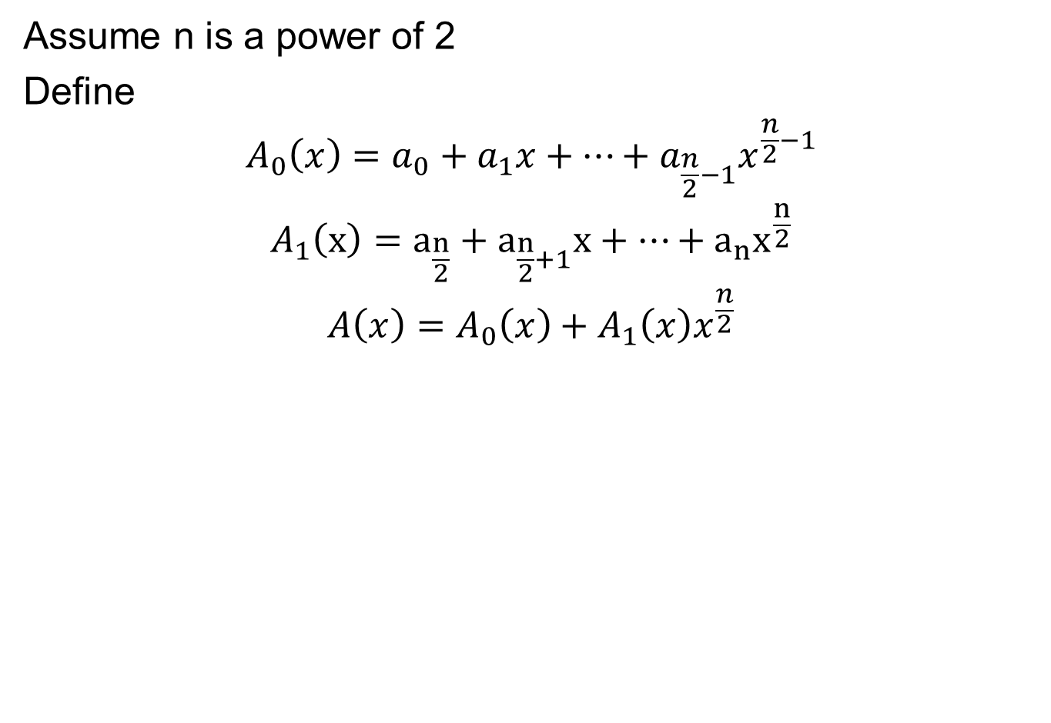
The First Divide-and-Conquer: Divide
Assume n is a power of 2
Define
$$A_{0}\left(x\right)=a_{0}+a_{1}x+…+a_{\frac{n}{2}−1}x^{\frac{n}{2}−1}$$
$$A_{1}（x）=a_{\frac{n}{2}}+a_{\frac{n}{2}+1}x+…+a_{n}x^{\frac{n}{2}}$$
$$A\left(x\right)=A_{0}\left(x\right)+A_{1}\left(x\right)x^{\frac{n}{2}}$$

Slide 30
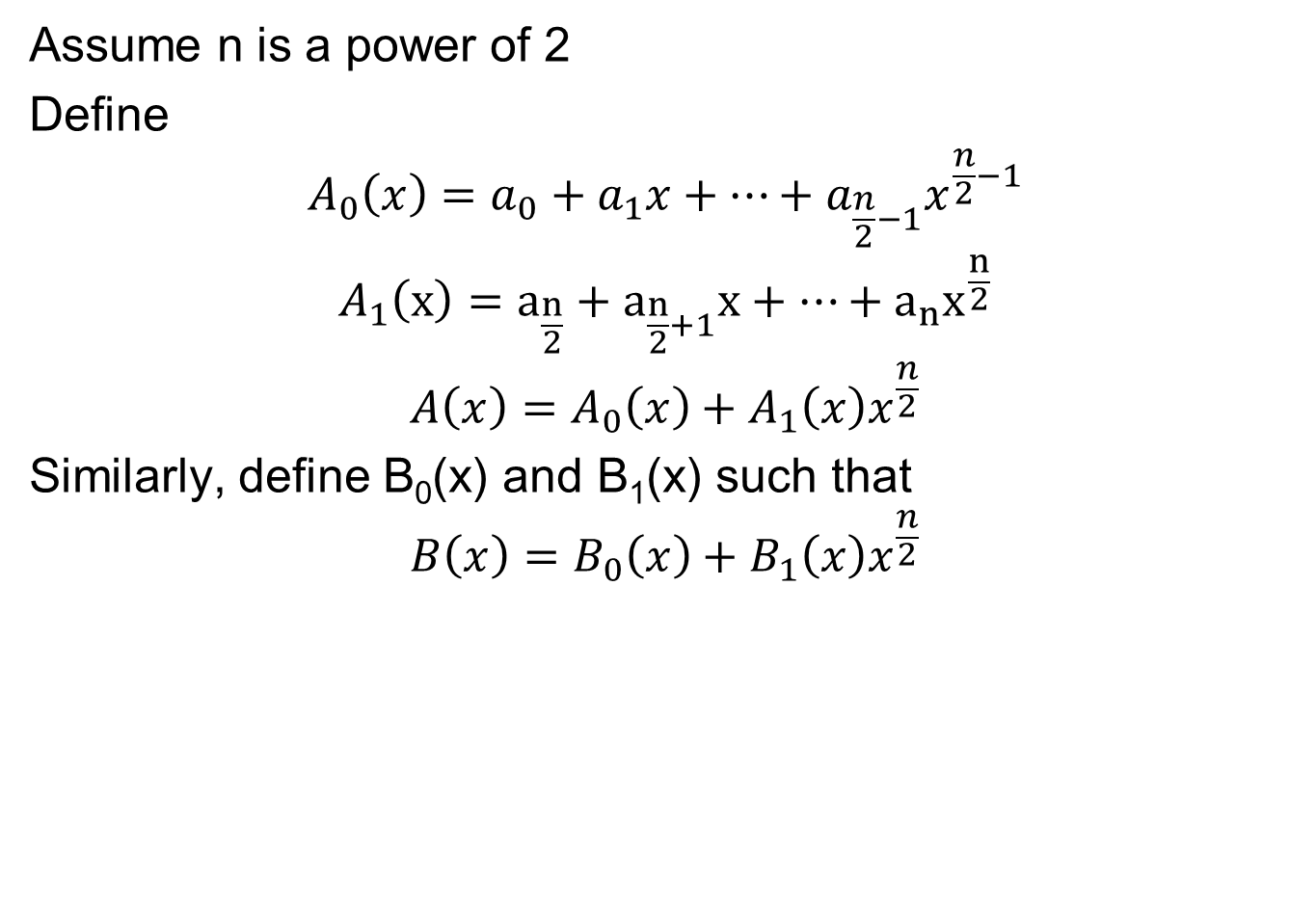
The First Divide-and-Conquer: Divide
Assume n is a power of 2
Define
$$A_{0}\left(x\right)=a_{0}+a_{1}x+…+a_{\frac{n}{2}−1}x^{\frac{n}{2}−1}$$
$$A_{1}（x）=a_{\frac{n}{2}}+a_{\frac{n}{2}+1}x+…+a_{n}x^{\frac{n}{2}}$$
$$A\left(x\right)=A_{0}\left(x\right)+A_{1}\left(x\right)x^{\frac{n}{2}}$$
Similarly, define B₀(x) and B₁(x) such that
$$B\left(x\right)=B_{0}\left(x\right)+B_{1}\left(x\right)x^{\frac{n}{2}}$$

Slide 31
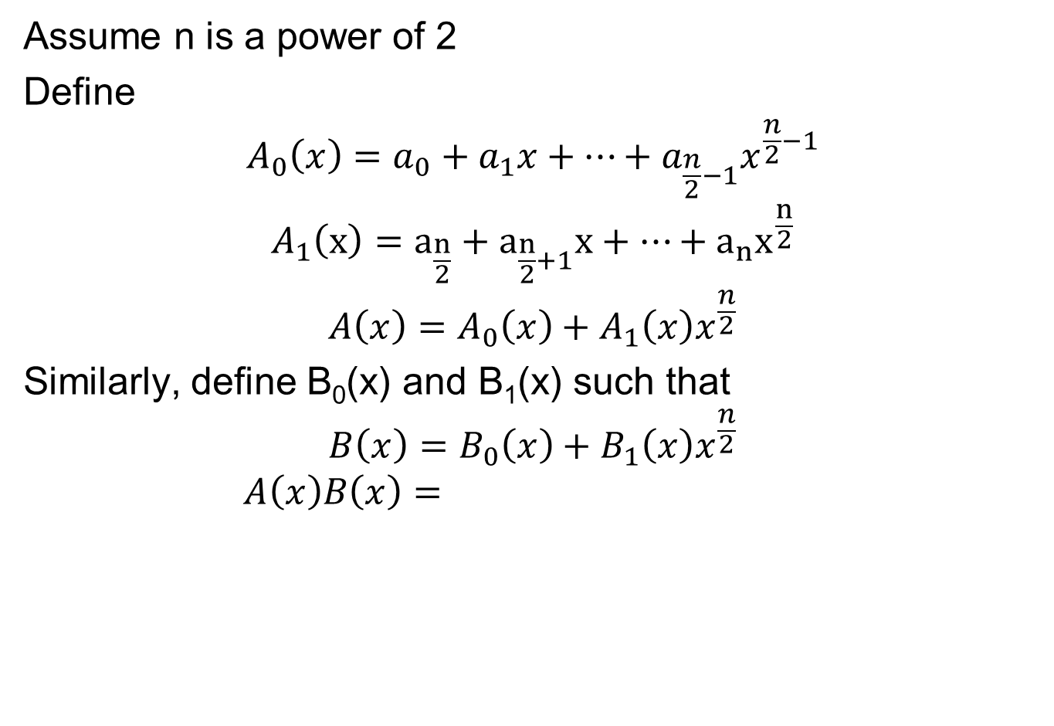
The First Divide-and-Conquer: Divide
Assume n is a power of 2
Define
$$A_{0}\left(x\right)=a_{0}+a_{1}x+…+a_{\frac{n}{2}−1}x^{\frac{n}{2}−1}$$
$$A_{1}（x）=a_{\frac{n}{2}}+a_{\frac{n}{2}+1}x+…+a_{n}x^{\frac{n}{2}}$$
$$A\left(x\right)=A_{0}\left(x\right)+A_{1}\left(x\right)x^{\frac{n}{2}}$$
Similarly, define B₀(x) and B₁(x) such that
$$B\left(x\right)=B_{0}\left(x\right)+B_{1}\left(x\right)x^{\frac{n}{2}}$$
$$A\left(x\right)B\left(x\right)=$$

Slide 32
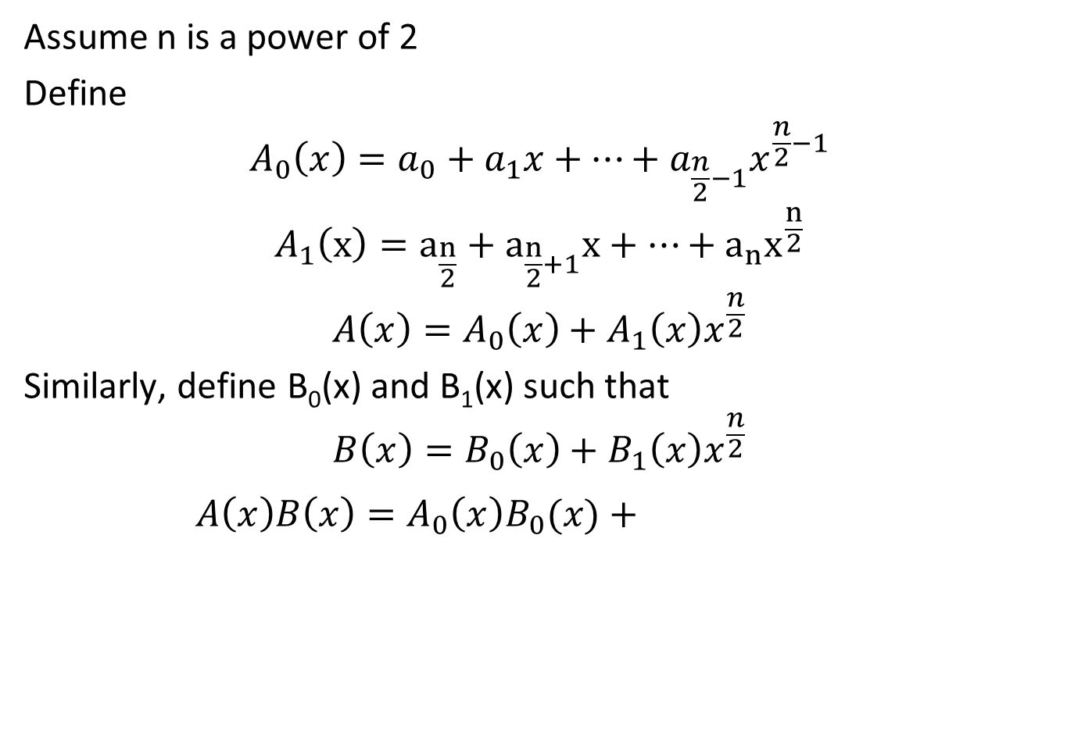
The First Divide-and-Conquer: Divide
Assume n is a power of 2
Define
$$A_{0}\left(x\right)=a_{0}+a_{1}x+…+a_{\frac{n}{2}−1}x^{\frac{n}{2}−1}$$
$$A_{1}（x）=a_{\frac{n}{2}}+a_{\frac{n}{2}+1}x+…+a_{n}x^{\frac{n}{2}}$$
$$A\left(x\right)=A_{0}\left(x\right)+A_{1}\left(x\right)x^{\frac{n}{2}}$$
Similarly, define B₀(x) and B₁(x) such that
$$B\left(x\right)=B_{0}\left(x\right)+B_{1}\left(x\right)x^{\frac{n}{2}}$$
$$A\left(x\right)B\left(x\right)=A_{0}\left(x\right)B_{0}(x)+A_{0}\left(x\right)B_{1}\left(x\right)x^{\frac{n}{2}}$$

Slide 33
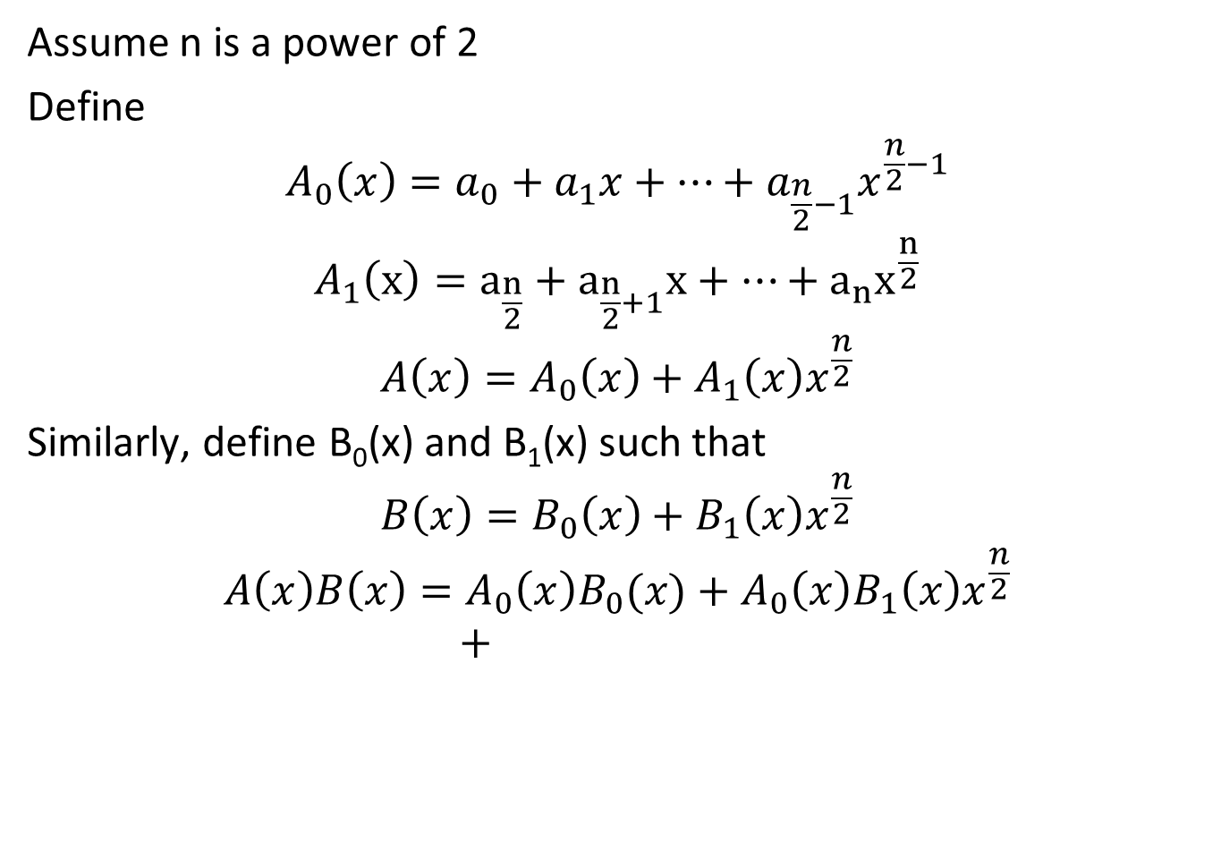
The First Divide-and-Conquer: Divide
Assume n is a power of 2
Define
$$A_{0}\left(x\right)=a_{0}+a_{1}x+…+a_{\frac{n}{2}−1}x^{\frac{n}{2}−1}$$
$$A_{1}（x）=a_{\frac{n}{2}}+a_{\frac{n}{2}+1}x+…+a_{n}x^{\frac{n}{2}}$$
$$A\left(x\right)=A_{0}\left(x\right)+A_{1}\left(x\right)x^{\frac{n}{2}}$$
Similarly, define B₀(x) and B₁(x) such that
$$B\left(x\right)=B_{0}\left(x\right)+B_{1}\left(x\right)x^{\frac{n}{2}}$$
$$A\left(x\right)B\left(x\right)=A_{0}\left(x\right)B_{0}(x)+A_{0}\left(x\right)B_{1}\left(x\right)x^{\frac{n}{2}} \\ +$$

Slide 34
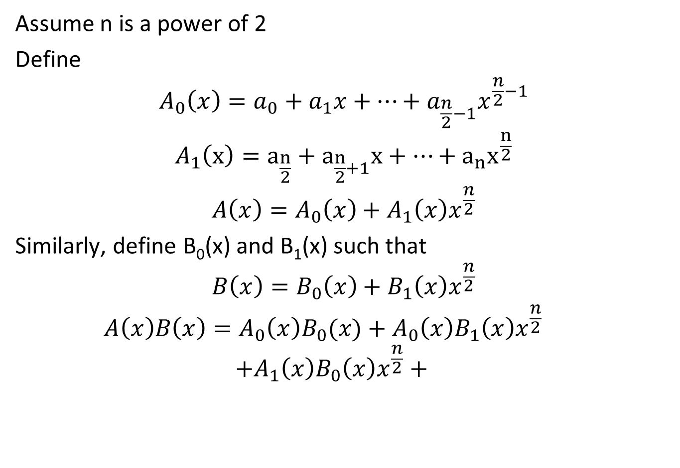
The First Divide-and-Conquer: Divide
Assume n is a power of 2
Define
$$A_{0}\left(x\right)=a_{0}+a_{1}x+…+a_{\frac{n}{2}−1}x^{\frac{n}{2}−1}$$
$$A_{1}（x）=a_{\frac{n}{2}}+a_{\frac{n}{2}+1}x+…+a_{n}x^{\frac{n}{2}}$$
$$A\left(x\right)=A_{0}\left(x\right)+A_{1}\left(x\right)x^{\frac{n}{2}}$$
Similarly, define B₀(x) and B₁(x) such that
$$B\left(x\right)=B_{0}\left(x\right)+B_{1}\left(x\right)x^{\frac{n}{2}}$$
$$A\left(x\right)B\left(x\right)=A_{0}\left(x\right)B_{0}(x)+A_{0}\left(x\right)B_{1}\left(x\right)x^{\frac{n}{2}} \\ +A_{1}\left(x\right)B_{0}\left(x\right)x^{\frac{n}{2}}+A_{1}\left(x\right)B_{1}\left(x\right)x^{n}$$

Slide 35
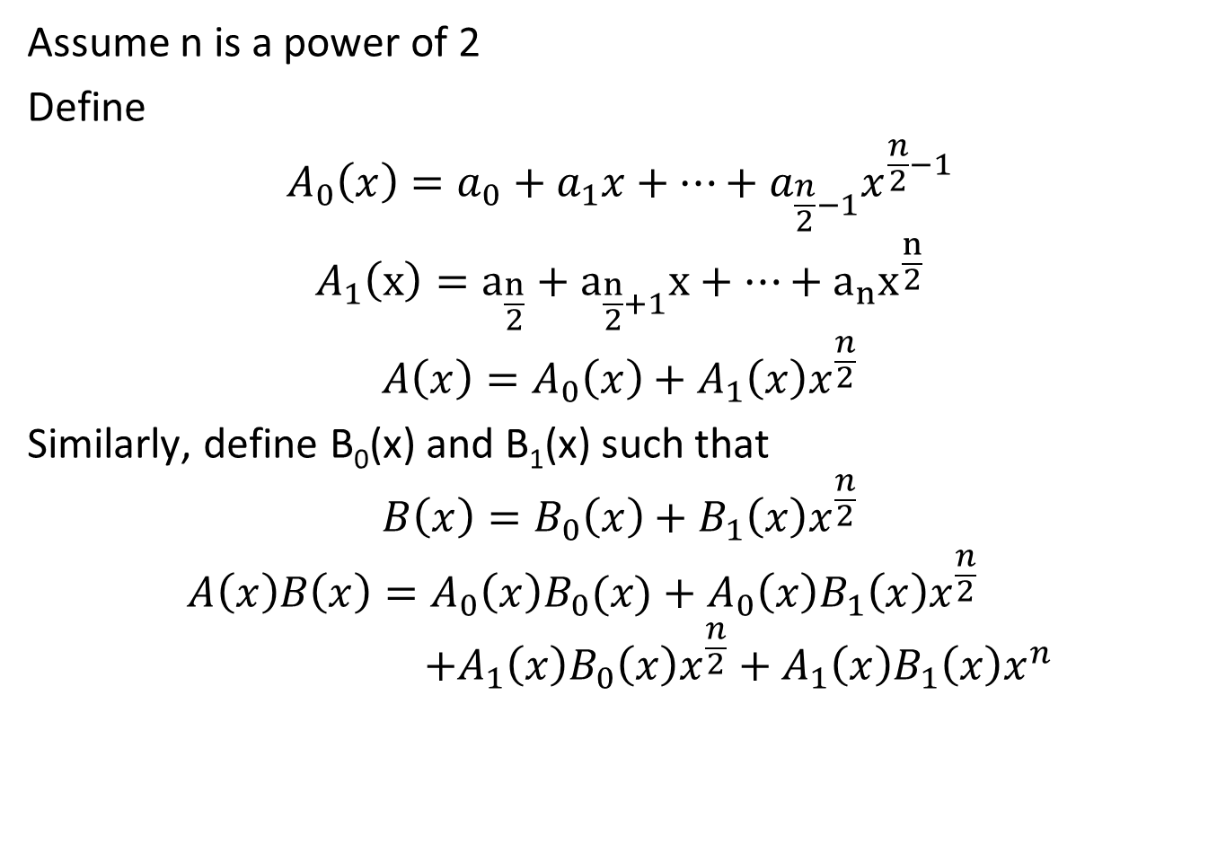
The First Divide-and-Conquer: Divide
Assume n is a power of 2
Define
$$A_{0}\left(x\right)=a_{0}+a_{1}x+…+a_{\frac{n}{2}−1}x^{\frac{n}{2}−1}$$
$$A_{1}（x）=a_{\frac{n}{2}}+a_{\frac{n}{2}+1}x+…+a_{n}x^{\frac{n}{2}}$$
$$A\left(x\right)=A_{0}\left(x\right)+A_{1}\left(x\right)x^{\frac{n}{2}}$$
Similarly, define B₀(x) and B₁(x) such that
$$B\left(x\right)=B_{0}\left(x\right)+B_{1}\left(x\right)x^{\frac{n}{2}}$$
$$A\left(x\right)B\left(x\right)=A_{0}\left(x\right)B_{0}(x)+A_{0}\left(x\right)B_{1}\left(x\right)x^{\frac{n}{2}} \\ +A_{1}\left(x\right)B_{0}\left(x\right)x^{\frac{n}{2}}+A_{1}\left(x\right)B_{1}\left(x\right)x^{n}$$

Slide 36
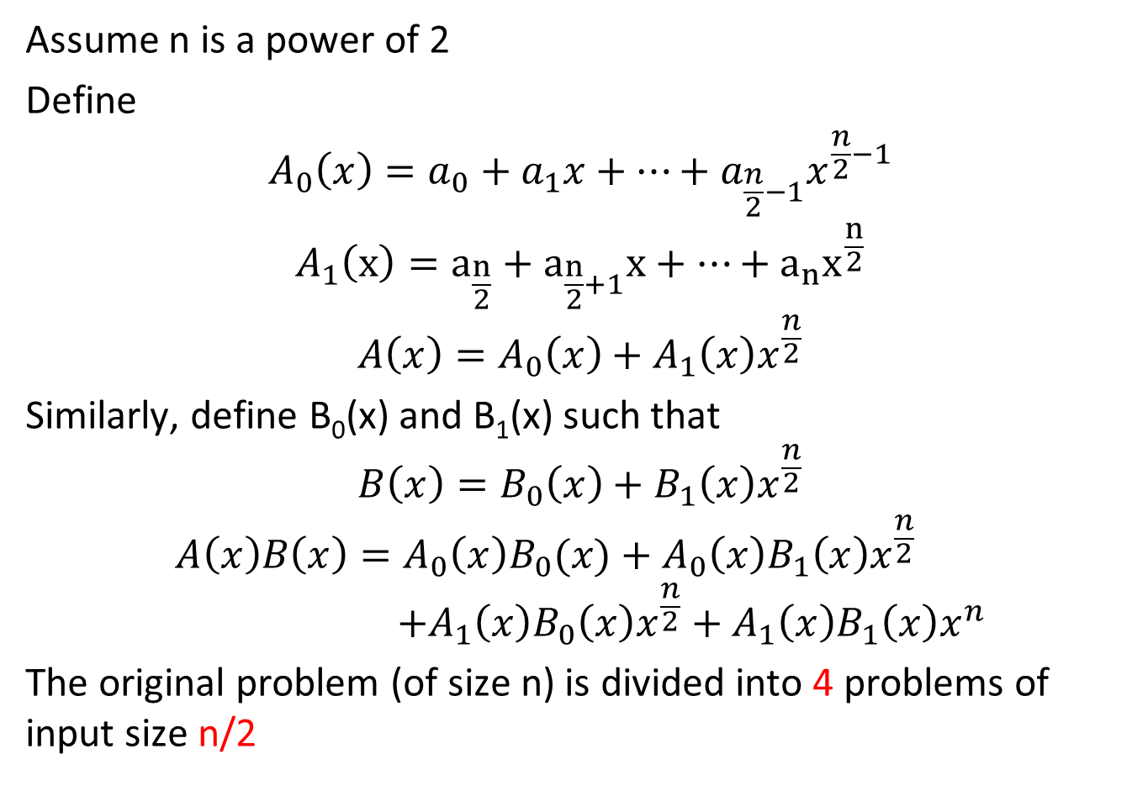
The First Divide-and-Conquer: Divide
Assume n is a power of 2
Define
$$A_{0}\left(x\right)=a_{0}+a_{1}x+…+a_{\frac{n}{2}−1}x^{\frac{n}{2}−1}$$
$$A_{1}（x）=a_{\frac{n}{2}}+a_{\frac{n}{2}+1}x+…+a_{n}x^{\frac{n}{2}}$$
$$A\left(x\right)=A_{0}\left(x\right)+A_{1}\left(x\right)x^{\frac{n}{2}}$$
Similarly, define B₀(x) and B₁(x) such that
$$B\left(x\right)=B_{0}\left(x\right)+B_{1}\left(x\right)x^{\frac{n}{2}}$$
$$A\left(x\right)B\left(x\right)=A_{0}\left(x\right)B_{0}(x)+A_{0}\left(x\right)B_{1}\left(x\right)x^{\frac{n}{2}} \\ +A_{1}\left(x\right)B_{0}\left(x\right)x^{\frac{n}{2}}+A_{1}\left(x\right)B_{1}\left(x\right)x^{n}$$
The original problem (of size n) is divided into 4 problems of input size n/2

Slide 37
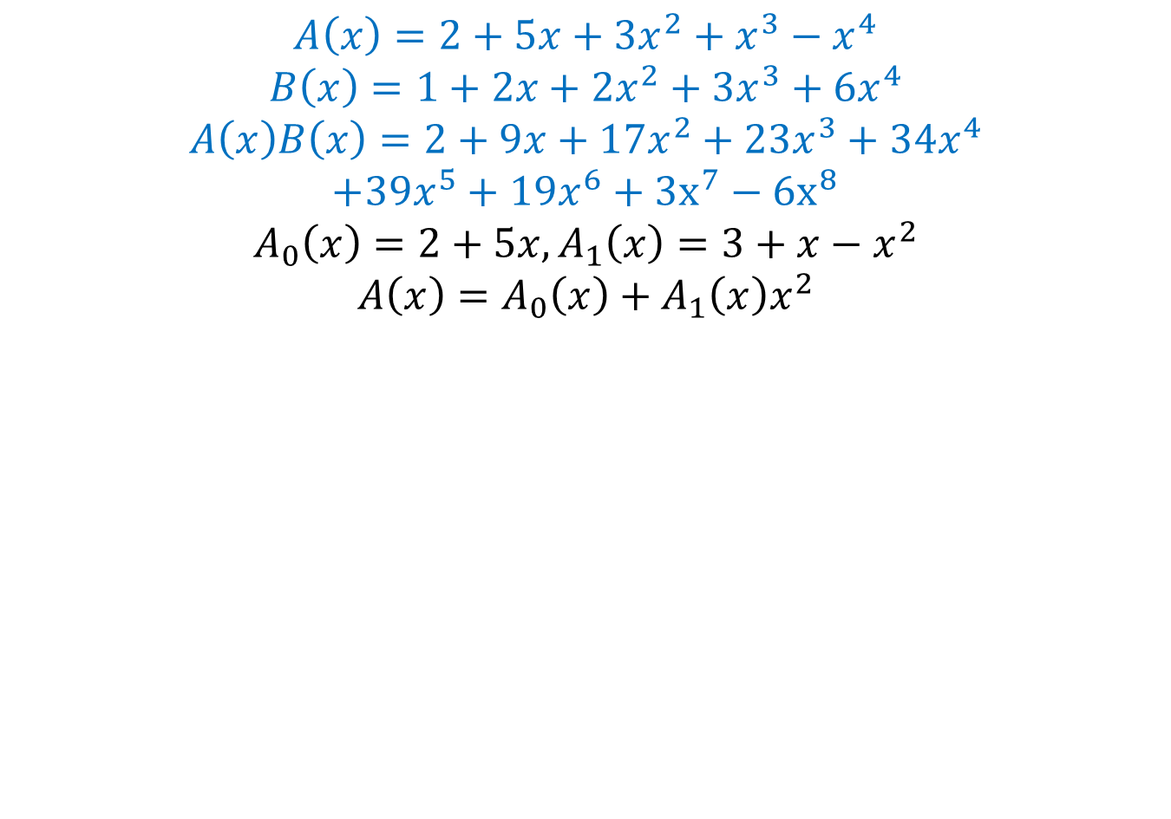
Example
$$A\left(x\right)=2+5x+3x^{2}+x^{3}−x^{4}$$
$$B\left(x\right)=1+2x+2x^{2}+3x^{3}+6x^{4}$$
$$A\left(x\right)B\left(x\right)=2+9x+17x^{2}+23x^{3}+34x^{4}$$
$$+39x^{5}+19x^{6}+3x^{7}−6x^{8}$$
$$A_{0}\left(x\right)=2+5x,A_{1}\left(x\right)=3+x−x^{2}$$
$$A\left(x\right)=A_{0}\left(x\right)+A_{1}\left(x\right)x^{2}$$

Slide 38
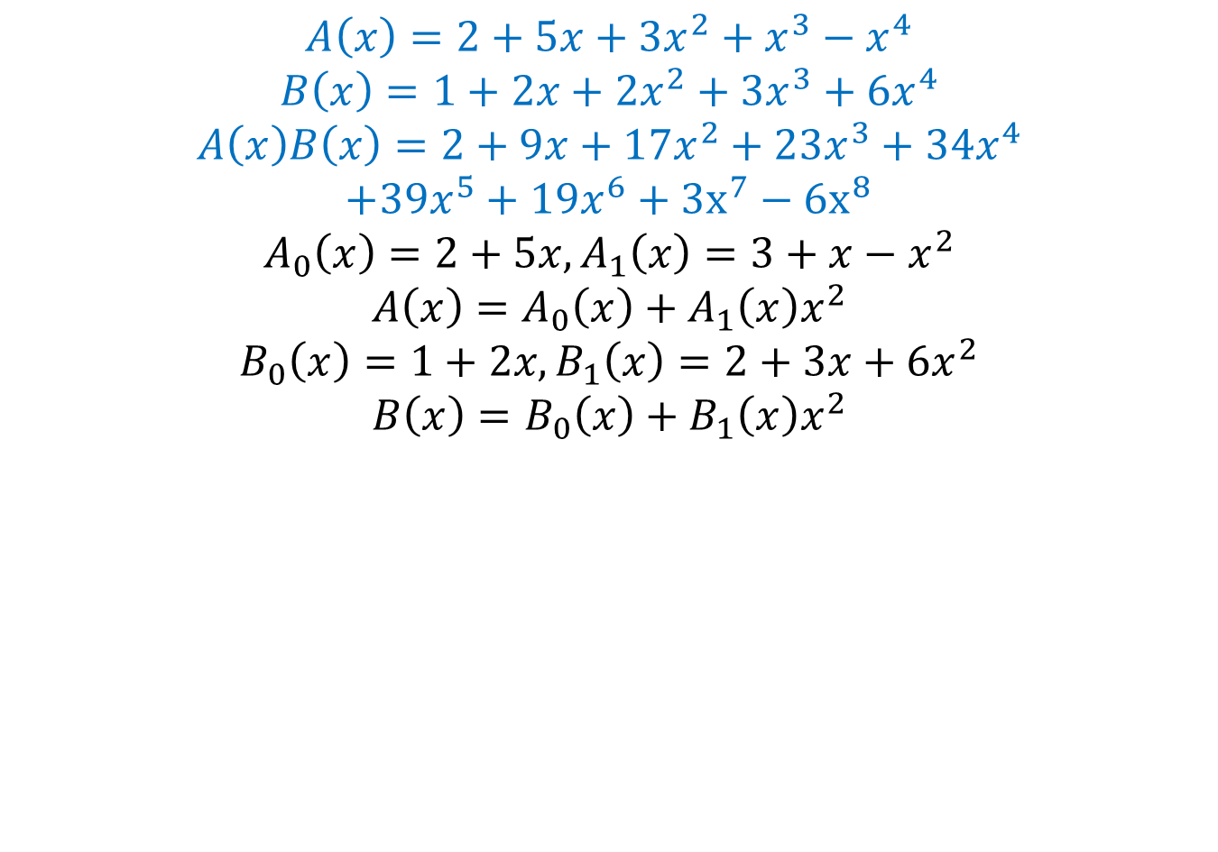
Example
$$A\left(x\right)=2+5x+3x^{2}+x^{3}−x^{4}$$
$$B\left(x\right)=1+2x+2x^{2}+3x^{3}+6x^{4}$$
$$A\left(x\right)B\left(x\right)=2+9x+17x^{2}+23x^{3}+34x^{4}$$
$$+39x^{5}+19x^{6}+3x^{7}−6x^{8}$$
$$A_{0}\left(x\right)=2+5x,A_{1}\left(x\right)=3+x−x^{2}$$
$$A\left(x\right)=A_{0}\left(x\right)+A_{1}\left(x\right)x^{2}$$
$$B_{0}\left(x\right)=1+2x,B_{1}\left(x\right)=2+3x+6x^{2}$$
$$B\left(x\right)=B_{0}\left(x\right)+B_{1}\left(x\right)x^{2}$$

Slide 39
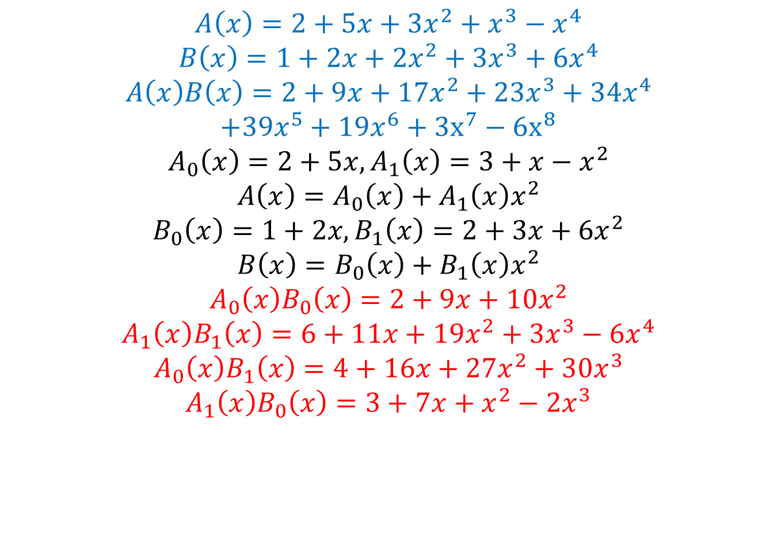
Example
$$A\left(x\right)=2+5x+3x^{2}+x^{3}−x^{4}$$
$$B\left(x\right)=1+2x+2x^{2}+3x^{3}+6x^{4}$$
$$A\left(x\right)B\left(x\right)=2+9x+17x^{2}+23x^{3}+34x^{4}$$
$$+39x^{5}+19x^{6}+3x^{7}−6x^{8}$$
$$A_{0}\left(x\right)=2+5x,A_{1}\left(x\right)=3+x−x^{2}$$
$$A\left(x\right)=A_{0}\left(x\right)+A_{1}\left(x\right)x^{2}$$
$$B_{0}\left(x\right)=1+2x,B_{1}\left(x\right)=2+3x+6x^{2}$$
$$B\left(x\right)=B_{0}\left(x\right)+B_{1}\left(x\right)x^{2}$$
$$A_{0}\left(x\right)B_{0}\left(x\right)=2+9x+10x^{2}$$
$$A_{1}\left(x\right)B_{1}\left(x\right)=6+11x+19x^{2}+3x^{3}−6x^{4}$$
$$A_{0}\left(x\right)B_{1}\left(x\right)=4+16x+27x^{2}+30x^{3}$$
$$A_{1}\left(x\right)B_{0}\left(x\right)=3+7x+x^{2}−2x^{3}$$

Slide 40
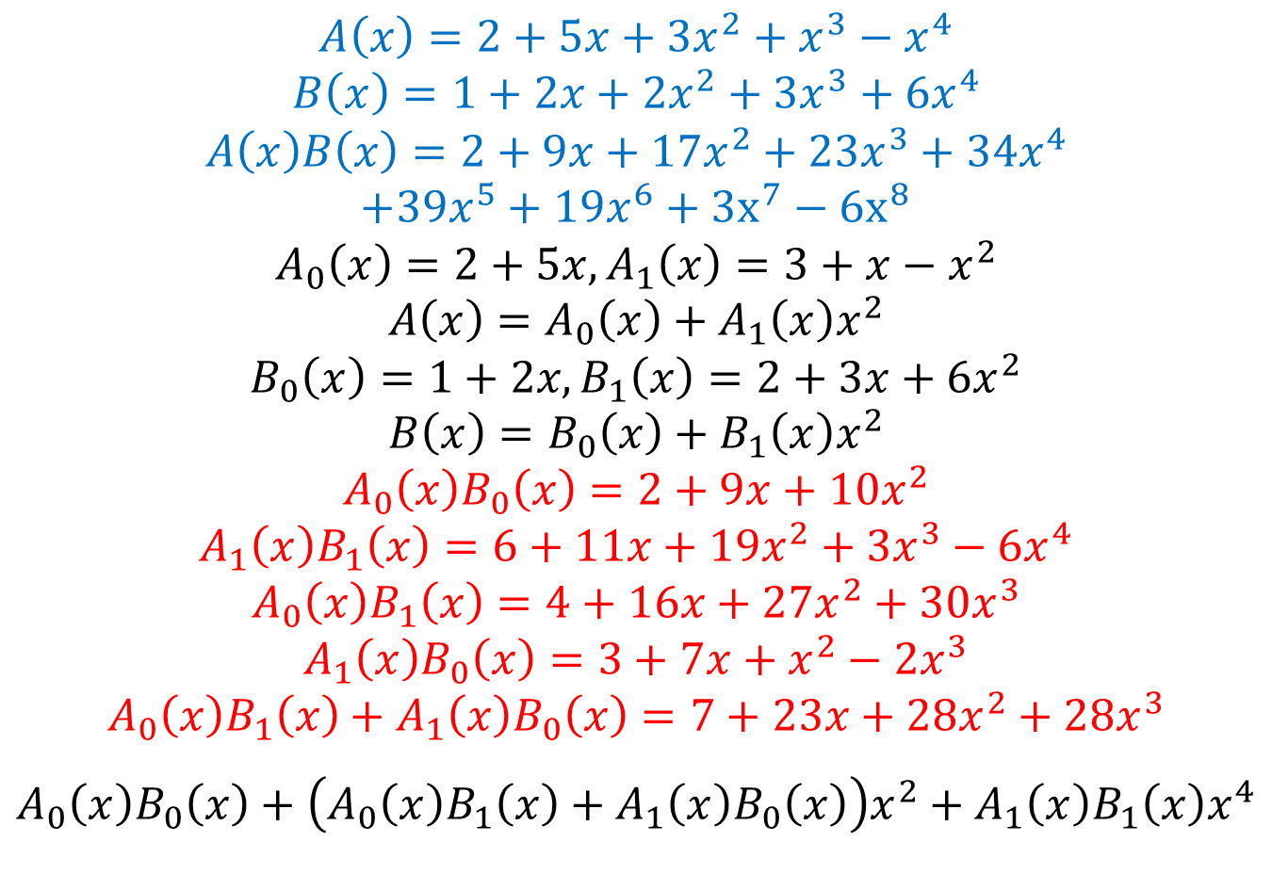
Example
$$A\left(x\right)=2+5x+3x^{2}+x^{3}−x^{4}$$
$$B\left(x\right)=1+2x+2x^{2}+3x^{3}+6x^{4}$$
$$A\left(x\right)B\left(x\right)=2+9x+17x^{2}+23x^{3}+34x^{4}$$
$$+39x^{5}+19x^{6}+3x^{7}−6x^{8}$$
$$A_{0}\left(x\right)=2+5x,A_{1}\left(x\right)=3+x−x^{2}$$
$$A\left(x\right)=A_{0}\left(x\right)+A_{1}\left(x\right)x^{2}$$
$$B_{0}\left(x\right)=1+2x,B_{1}\left(x\right)=2+3x+6x^{2}$$
$$B\left(x\right)=B_{0}\left(x\right)+B_{1}\left(x\right)x^{2}$$
$$A_{0}\left(x\right)B_{0}\left(x\right)=2+9x+10x^{2}$$
$$A_{1}\left(x\right)B_{1}\left(x\right)=6+11x+19x^{2}+3x^{3}−6x^{4}$$
$$A_{0}\left(x\right)B_{1}\left(x\right)=4+16x+27x^{2}+30x^{3}$$
$$A_{1}\left(x\right)B_{0}\left(x\right)=3+7x+x^{2}−2x^{3}$$
$$A_{0}\left(x\right)B_{1}\left(x\right)+A_{1}\left(x\right)B_{0}\left(x\right)=7+23x+28x^{2}+28x^{3}$$
$$A_{0}\left(x\right)B_{0}\left(x\right)+\left(A_{0}\left(x\right)B_{1}\left(x\right)+A_{1}\left(x\right)B_{0}\left(x\right)\right)x^{2}+A_{1}\left(x\right)B_{1}\left(x\right)x^{4}$$

Slide 41
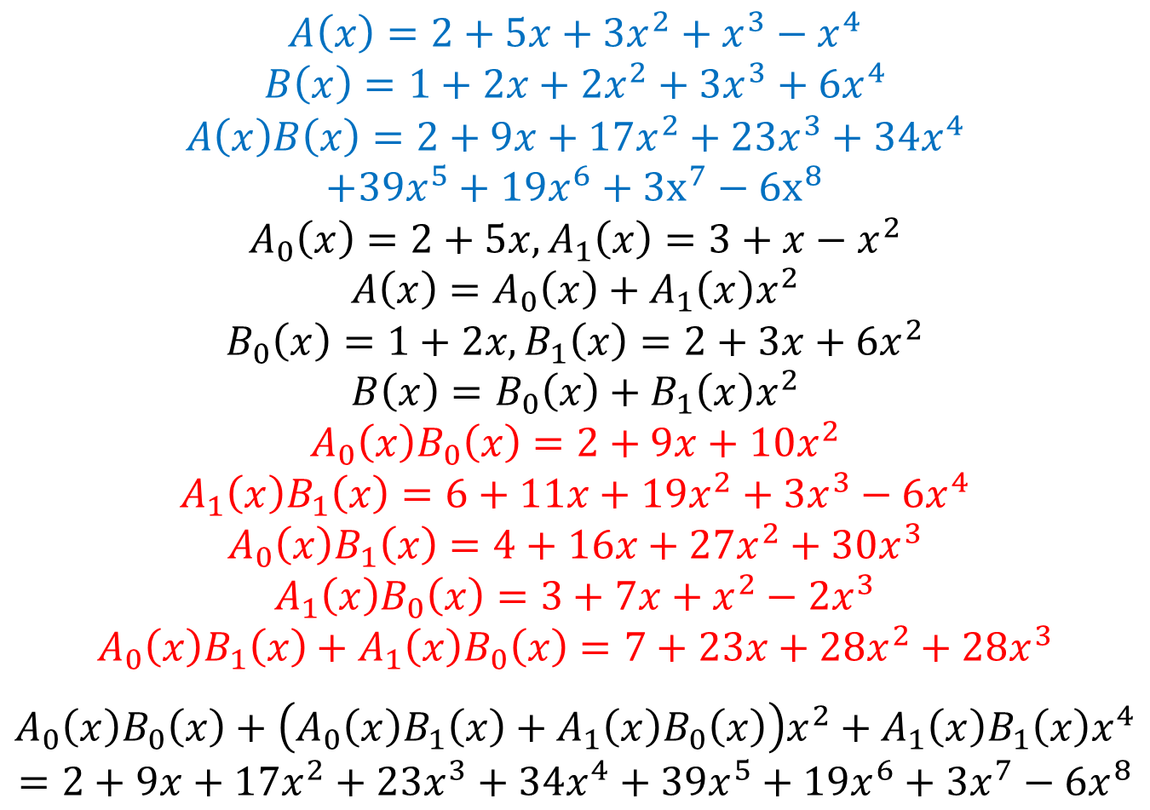
Example
$$A\left(x\right)=2+5x+3x^{2}+x^{3}−x^{4}$$
$$B\left(x\right)=1+2x+2x^{2}+3x^{3}+6x^{4}$$
$$A\left(x\right)B\left(x\right)=2+9x+17x^{2}+23x^{3}+34x^{4}$$
$$+39x^{5}+19x^{6}+3x^{7}−6x^{8}$$
$$A_{0}\left(x\right)=2+5x,A_{1}\left(x\right)=3+x−x^{2}$$
$$A\left(x\right)=A_{0}\left(x\right)+A_{1}\left(x\right)x^{2}$$
$$B_{0}\left(x\right)=1+2x,B_{1}\left(x\right)=2+3x+6x^{2}$$
$$B\left(x\right)=B_{0}\left(x\right)+B_{1}\left(x\right)x^{2}$$
$$A_{0}\left(x\right)B_{0}\left(x\right)=2+9x+10x^{2}$$
$$A_{1}\left(x\right)B_{1}\left(x\right)=6+11x+19x^{2}+3x^{3}−6x^{4}$$
$$A_{0}\left(x\right)B_{1}\left(x\right)=4+16x+27x^{2}+30x^{3}$$
$$A_{1}\left(x\right)B_{0}\left(x\right)=3+7x+x^{2}−2x^{3}$$
$$A_{0}\left(x\right)B_{1}\left(x\right)+A_{1}\left(x\right)B_{0}\left(x\right)=7+23x+28x^{2}+28x^{3}$$
$$A_{0}\left(x\right)B_{0}\left(x\right)+\left(A_{0}\left(x\right)B_{1}\left(x\right)+A_{1}\left(x\right)B_{0}\left(x\right)\right)x^{2}+A_{1}\left(x\right)B_{1}\left(x\right)x^{4}$$
$$=2+9x+17x^{2}+23x^{3}+34x^{4}+39x^{5}+19x^{6}+3x^{7}−6x^{8}$$

Slide 42
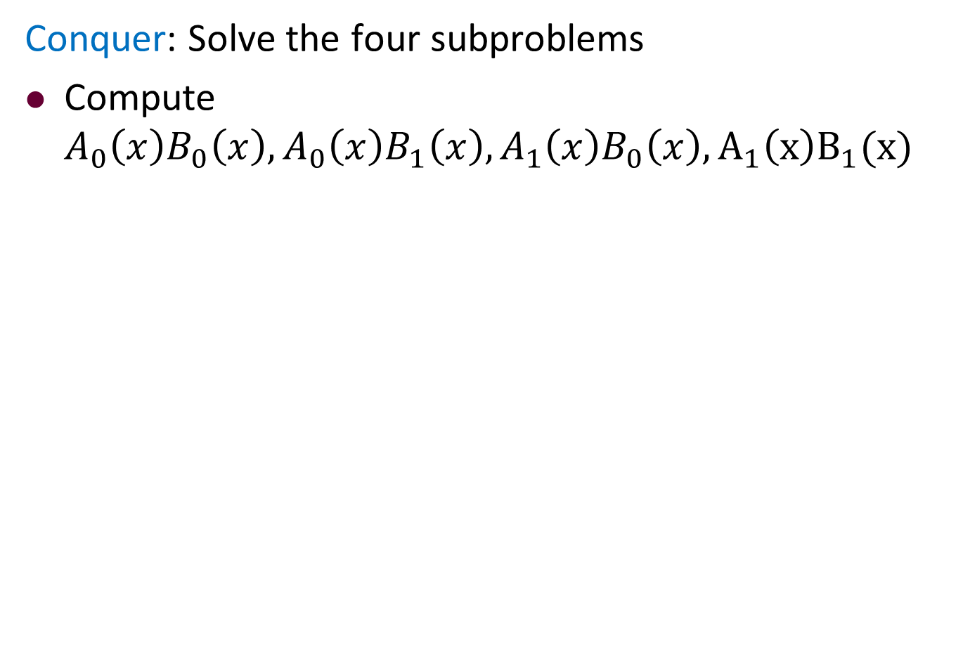
The First Divide-and-Conquer: Conquer
Conquer: Solve the four subproblems
Compute
$$A_{0}\left(x\right)B_{0}\left(x\right), A_{0}\left(x\right)B_{1}\left(x\right), A_{1}\left(x\right)B_{0}\left(x\right),A_{1}\left(x\right)B_{1}(x)$$

Slide 43
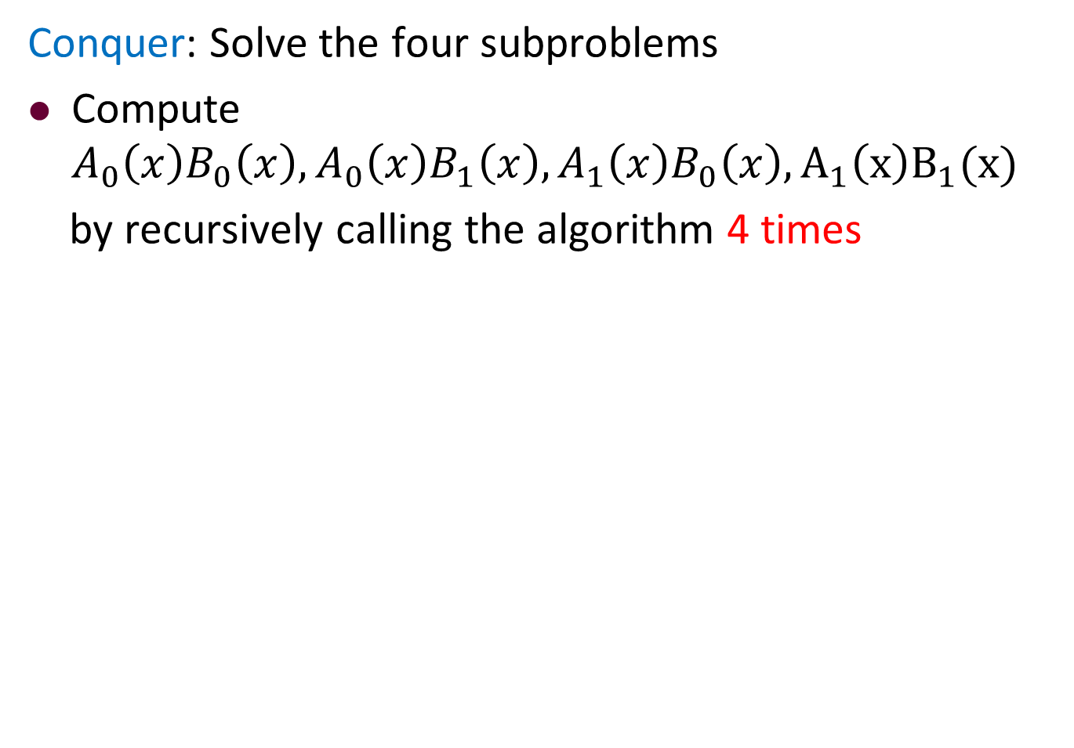
The First Divide-and-Conquer: Conquer
Conquer: Solve the four subproblems
Compute
$$A_{0}\left(x\right)B_{0}\left(x\right), A_{0}\left(x\right)B_{1}\left(x\right), A_{1}\left(x\right)B_{0}\left(x\right),A_{1}\left(x\right)B_{1}(x)$$
by recursively calling the algorithm 4 times

Slide 44
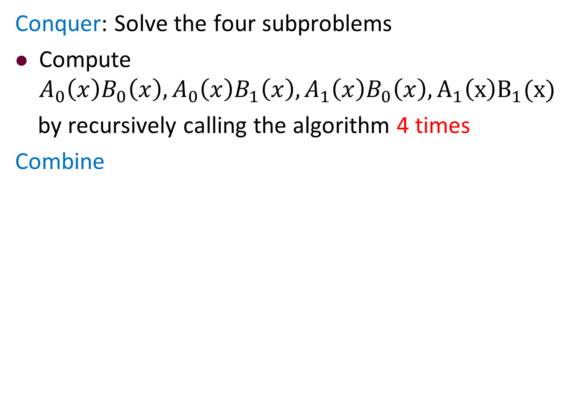
The First Divide-and-Conquer: Conquer
Conquer: Solve the four subproblems
Compute
$$A_{0}\left(x\right)B_{0}\left(x\right), A_{0}\left(x\right)B_{1}\left(x\right), A_{1}\left(x\right)B_{0}\left(x\right),A_{1}\left(x\right)B_{1}(x)$$
by recursively calling the algorithm 4 times
Combine

Slide 45
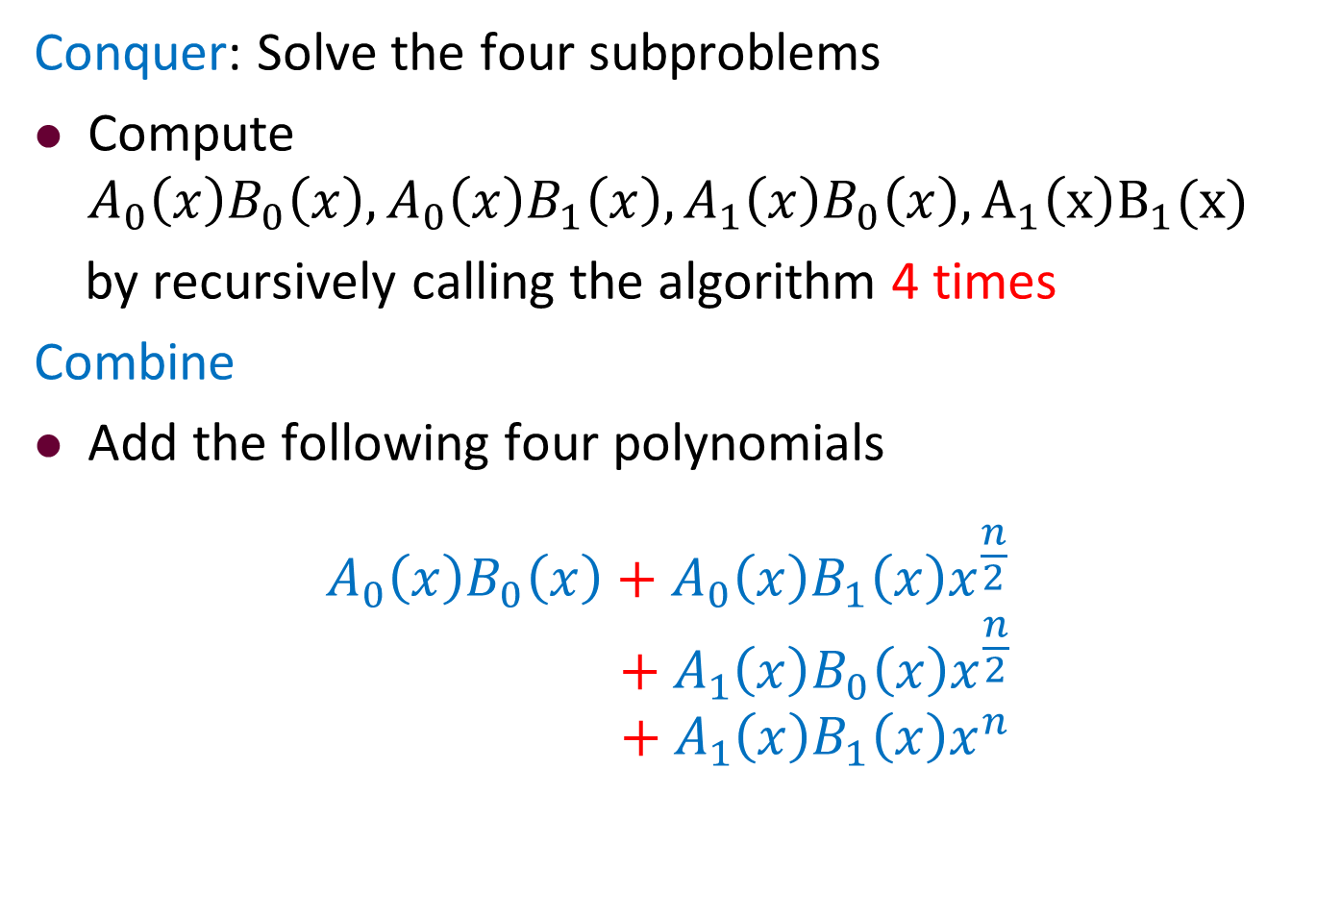
The First Divide-and-Conquer: Conquer
Conquer: Solve the four subproblems
Compute
$$A_{0}\left(x\right)B_{0}\left(x\right), A_{0}\left(x\right)B_{1}\left(x\right), A_{1}\left(x\right)B_{0}\left(x\right),A_{1}\left(x\right)B_{1}(x)$$
by recursively calling the algorithm 4 times
Combine
Add the following four polynomials
$$A_{0}\left(x\right)B_{0}\left(x\right)+A_{0}\left(x\right)B_{1}\left(x\right)x^{\frac{n}{2}}$$
$$+ A_{1}\left(x\right)B_{0}\left(x\right)x^{\frac{n}{2}}$$
$${ + A}_{1}\left(x\right)B_{1}\left(x\right)x^{n}$$

Slide 46
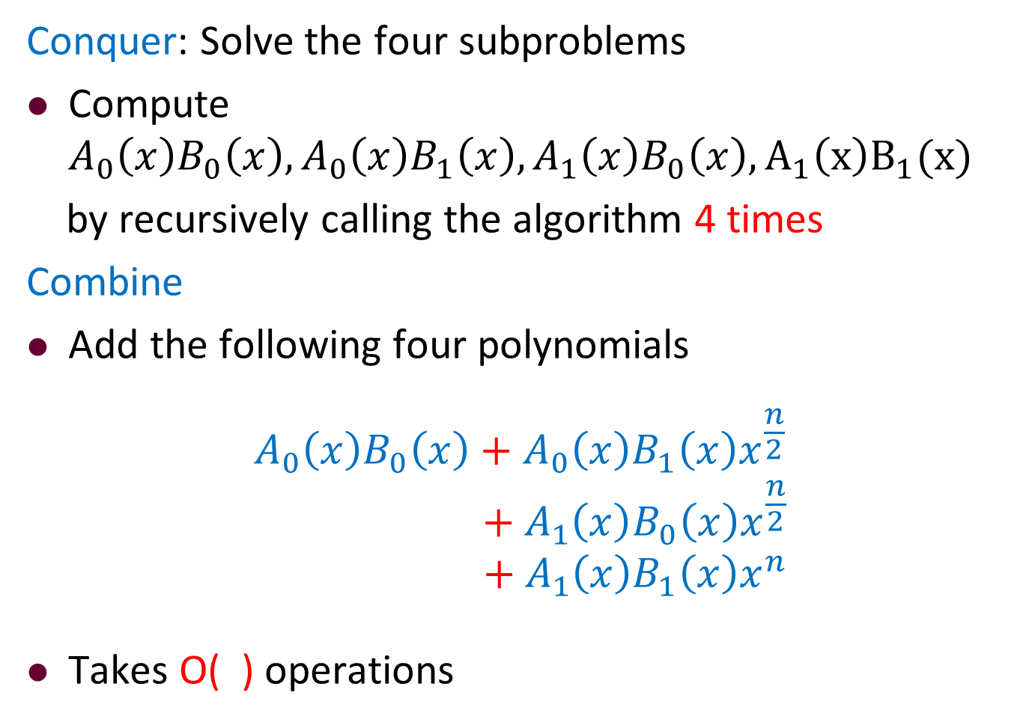
The First Divide-and-Conquer: Conquer
Conquer: Solve the four subproblems
Compute
$$A_{0}\left(x\right)B_{0}\left(x\right), A_{0}\left(x\right)B_{1}\left(x\right), A_{1}\left(x\right)B_{0}\left(x\right),A_{1}\left(x\right)B_{1}(x)$$
by recursively calling the algorithm 4 times
Combine
Add the following four polynomials
$$A_{0}\left(x\right)B_{0}\left(x\right)+A_{0}\left(x\right)B_{1}\left(x\right)x^{\frac{n}{2}}$$
$$+ A_{1}\left(x\right)B_{0}\left(x\right)x^{\frac{n}{2}}$$
$${ + A}_{1}\left(x\right)B_{1}\left(x\right)x^{n}$$
Takes O( ) operations

Slide 47

The First Divide-and-Conquer: Conquer
Conquer: Solve the four subproblems
Compute
$$A_{0}\left(x\right)B_{0}\left(x\right), A_{0}\left(x\right)B_{1}\left(x\right), A_{1}\left(x\right)B_{0}\left(x\right),A_{1}\left(x\right)B_{1}(x)$$
by recursively calling the algorithm 4 times
Combine
Add the following four polynomials
$$A_{0}\left(x\right)B_{0}\left(x\right)+A_{0}\left(x\right)B_{1}\left(x\right)x^{\frac{n}{2}}$$
$$+ A_{1}\left(x\right)B_{0}\left(x\right)x^{\frac{n}{2}}$$
$${ + A}_{1}\left(x\right)B_{1}\left(x\right)x^{n}$$
Takes O(n) operations

Slide 48
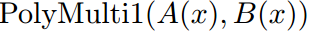
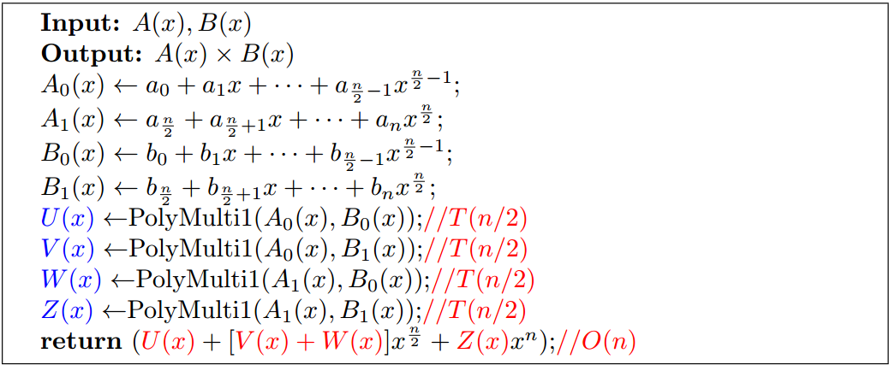
The First Divide-and-Conquer Algorithm

Slide 49
The First Divide-and-Conquer Algorithm

Slide 50
The First Divide-and-Conquer Algorithm

Slide 51
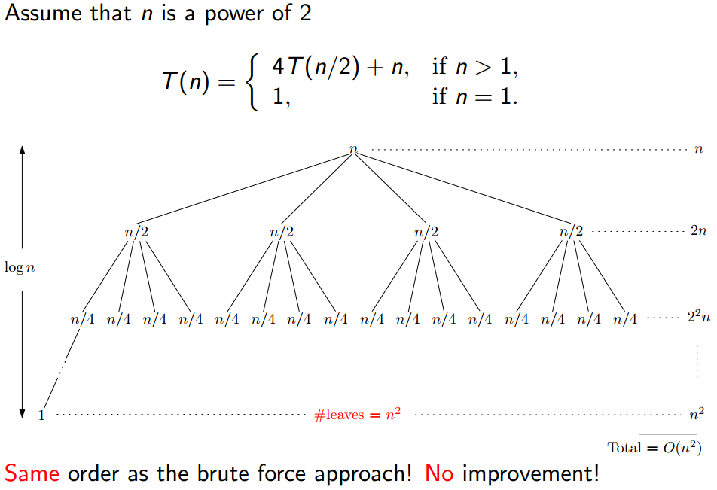
The First Divide-and-Conquer Algorithm

Slide 52
Analysis of Running Time

Slide 53
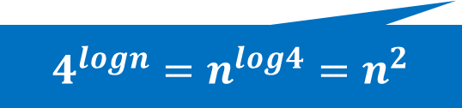
Analysis of Running Time
$4^{logn}=$ $n^{log4}=n^{2}$

Slide 54
Analysis of Running Time

Slide 55
Analysis of Running Time

Slide 56
Outline
Review to Divide-and-Conquer Paradigm
Polynomial Multiplication Problem
Problem definition
A brute force algorithm
A first divide-and-conquer algorithm
An improved divide-and-conquer algorithm
Analysis of the divide-and-conquer algorithm
Quicksort Problem
Basic partition
Randomized partition and randomized quicksort
Analysis of the randomized quicksort

Slide 57
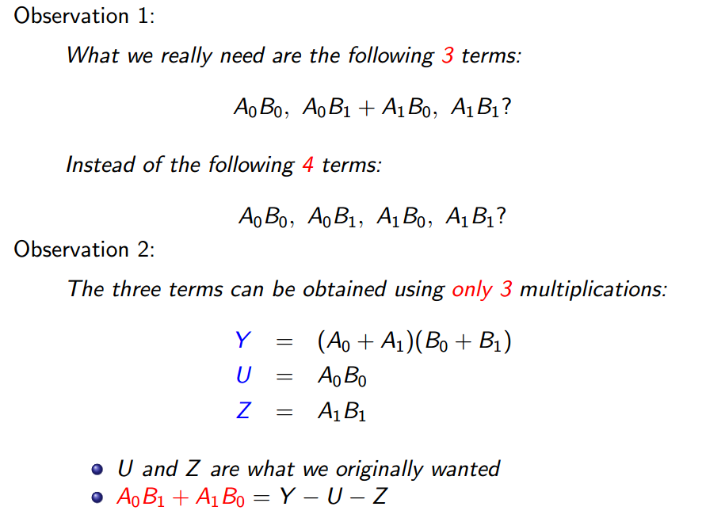
Two Observations

Slide 58
Two Observations

Slide 59
Two Observations

Slide 60
Two Observations

Slide 61
Two Observations

Slide 62
Two Observations

Slide 63
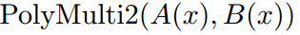
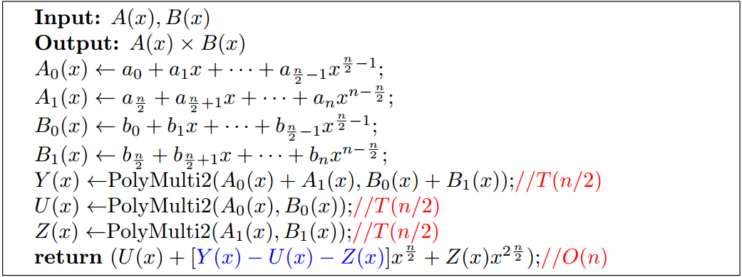
The improved Divide-and-Conquer Algorithm

Slide 64
The improved Divide-and-Conquer Algorithm

Slide 65
The Second Divide-and-Conquer Algorithm

Slide 66
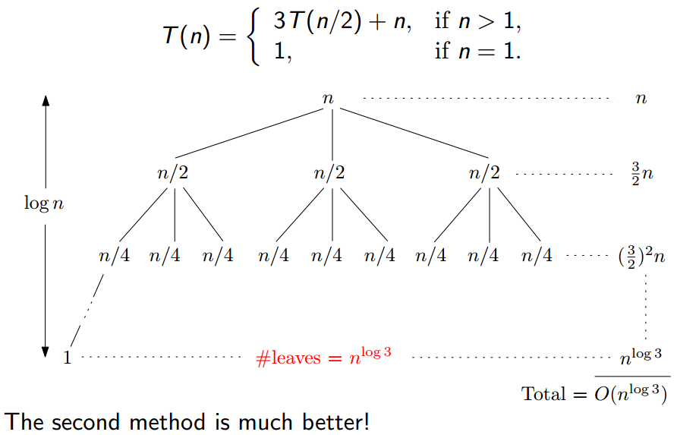
The improved Divide-and-Conquer Algorithm

Slide 67
Running Time of the Improved Algorithm

Slide 68

Running Time of the Improved Algorithm
$3^{logn}=$ $n^{log3}$

Slide 69
Running Time of the Improved Algorithm

Slide 70
Outline
Review to Divide-and-Conquer Paradigm
Polynomial Multiplication Problem
Problem definition
A brute force algorithm
A first divide-and-conquer algorithm
An improved divide-and-conquer algorithm
Analysis of the divide-and-conquer algorithm
Quicksort Problem
Basic partition
Randomized partition and randomized quicksort
Analysis of the randomized quicksort

Slide 71
Analysis of the D&C algorithm
The divide-and-conquer approach does not always give you the best solution
Our original algorithm was just as bad as brute force

Slide 72
Analysis of the D&C algorithm
The divide-and-conquer approach does not always give you the best solution
Our original algorithm was just as bad as brute force
There is actually an O(n log n) solution to the polynomial multiplication problem

Slide 73
Analysis of the D&C algorithm
The divide-and-conquer approach does not always give you the best solution
Our original algorithm was just as bad as brute force
There is actually an O(n log n) solution to the polynomial multiplication problem
It involves using the Fast Fourier Transform algorithm as a subroutine
The FFT is another classic divide-and-conquer algorithm(check Chapt 30 in CLRS if interested)

Slide 74
Analysis of the D&C algorithm
The divide-and-conquer approach does not always give you the best solution
Our original algorithm was just as bad as brute force
There is actually an O(n log n) solution to the polynomial multiplication problem
It involves using the Fast Fourier Transform algorithm as a subroutine
The FFT is another classic divide-and-conquer algorithm(check Chapt 30 in CLRS if interested)
The idea of using 3 multiplications instead of 4 is used in large-integer multiplications
A similar idea is the basis of the classic Strassen matrix multiplication algorithm (CLRS 4.2)

Slide 75
Outline
Review to Divide-and-Conquer Paradigm
Polynomial Multiplication Problem
Problem definition
A brute force algorithm
A first divide-and-conquer algorithm
An improved divide-and-conquer algorithm
Analysis of the divide-and-conquer algorithm
Quicksort Problem
Basic partition
Randomized partition and randomized quicksort
Analysis of the randomized quicksort

Slide 76
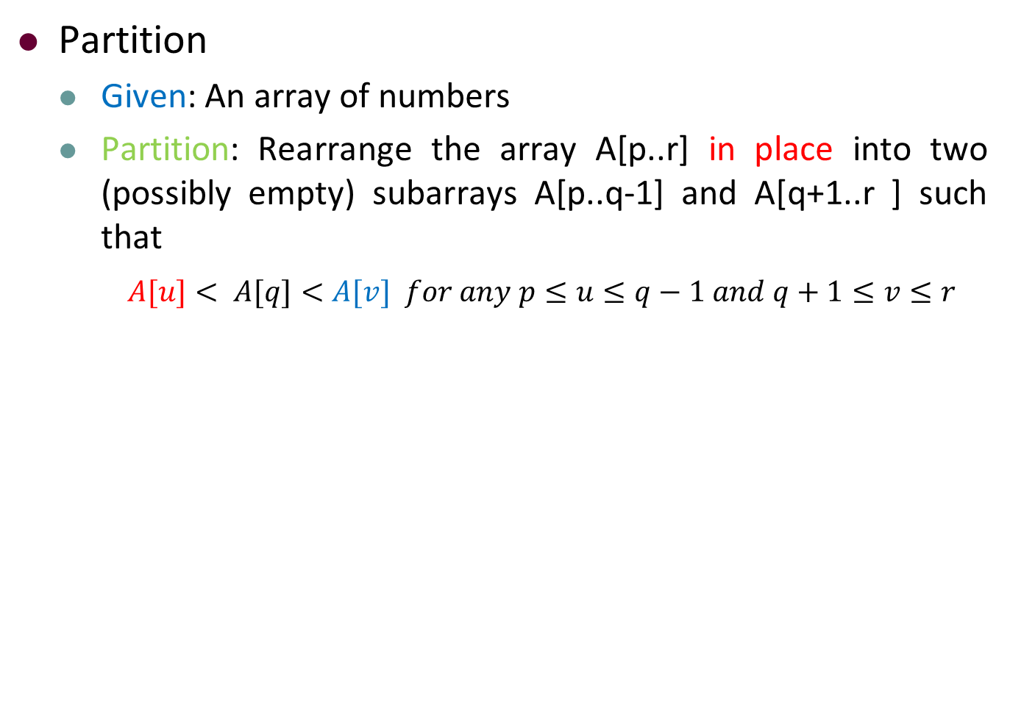
Partition
Partition
Given: An array of numbers
Partition: Rearrange the array A[p..r] in place into two (possibly empty) subarrays A[p..q-1] and A[q+1..r ] such that
$A[u]< A[q]<A[v] for any p≤u≤q−1 and q+1≤v≤r$

Slide 77
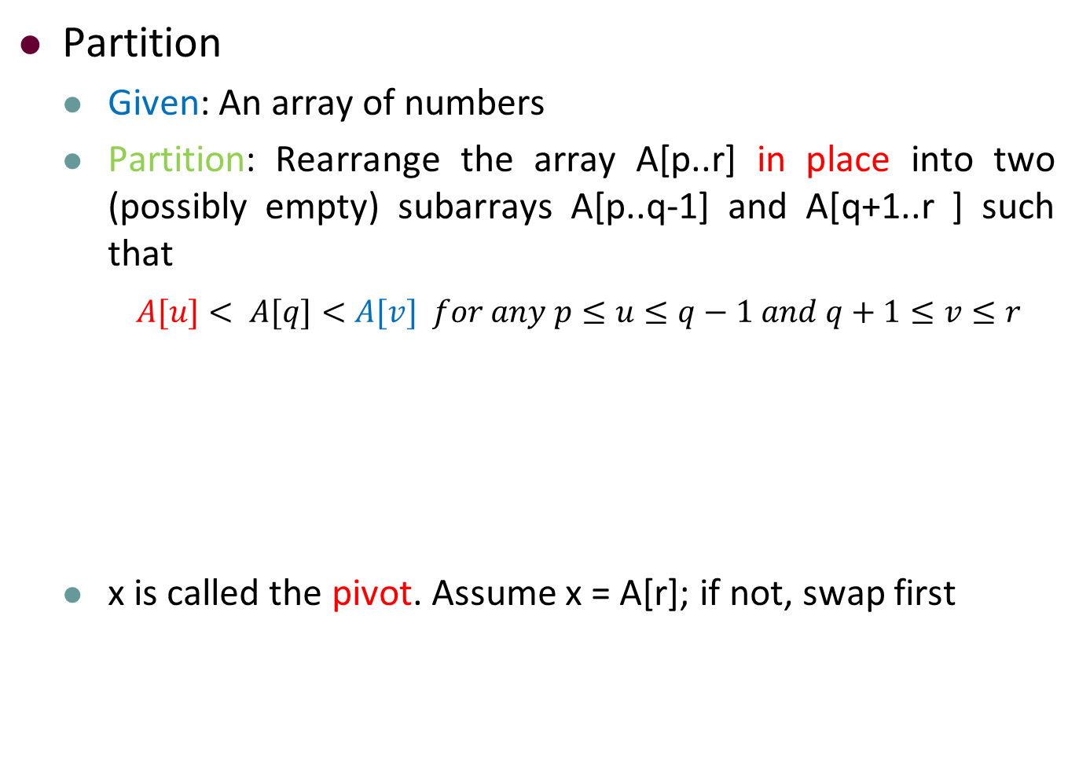
Partition
Partition
Given: An array of numbers
Partition: Rearrange the array A[p..r] in place into two (possibly empty) subarrays A[p..q-1] and A[q+1..r ] such that
$A[u]< A[q]<A[v] for any p≤u≤q−1 and q+1≤v≤r$
x is called the pivot. Assume x = A[r]; if not, swap first

Slide 78
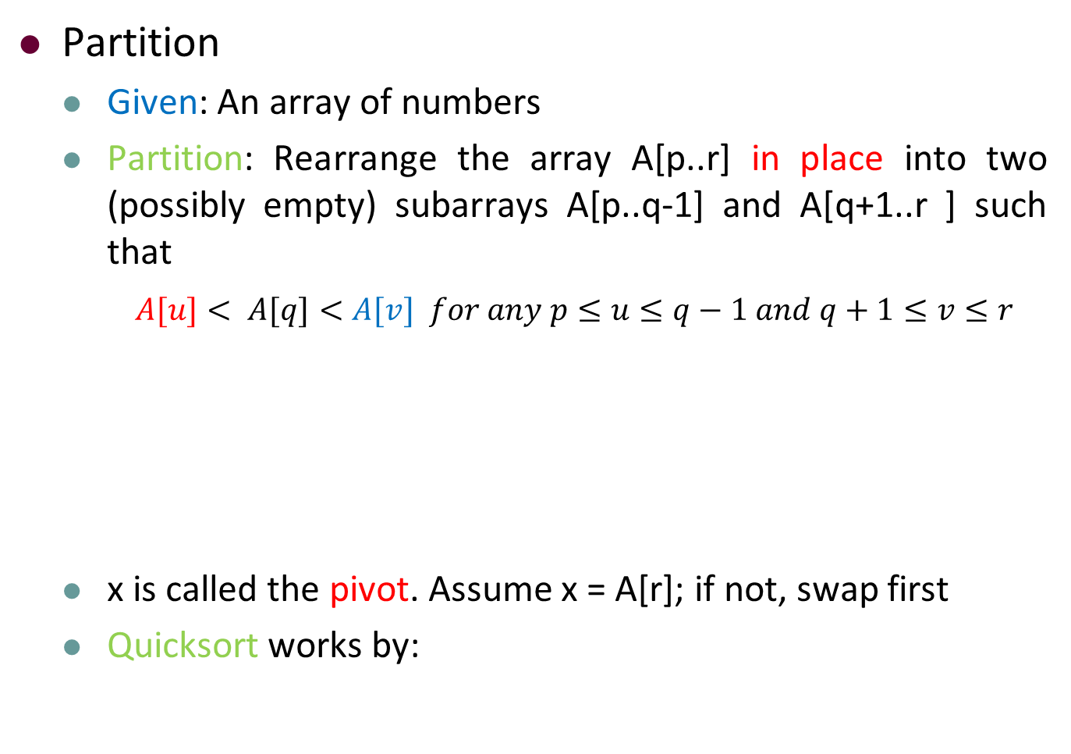
Partition
Partition
Given: An array of numbers
Partition: Rearrange the array A[p..r] in place into two (possibly empty) subarrays A[p..q-1] and A[q+1..r ] such that
$A[u]< A[q]<A[v] for any p≤u≤q−1 and q+1≤v≤r$
x is called the pivot. Assume x = A[r]; if not, swap first
Quicksort works by:

Slide 79
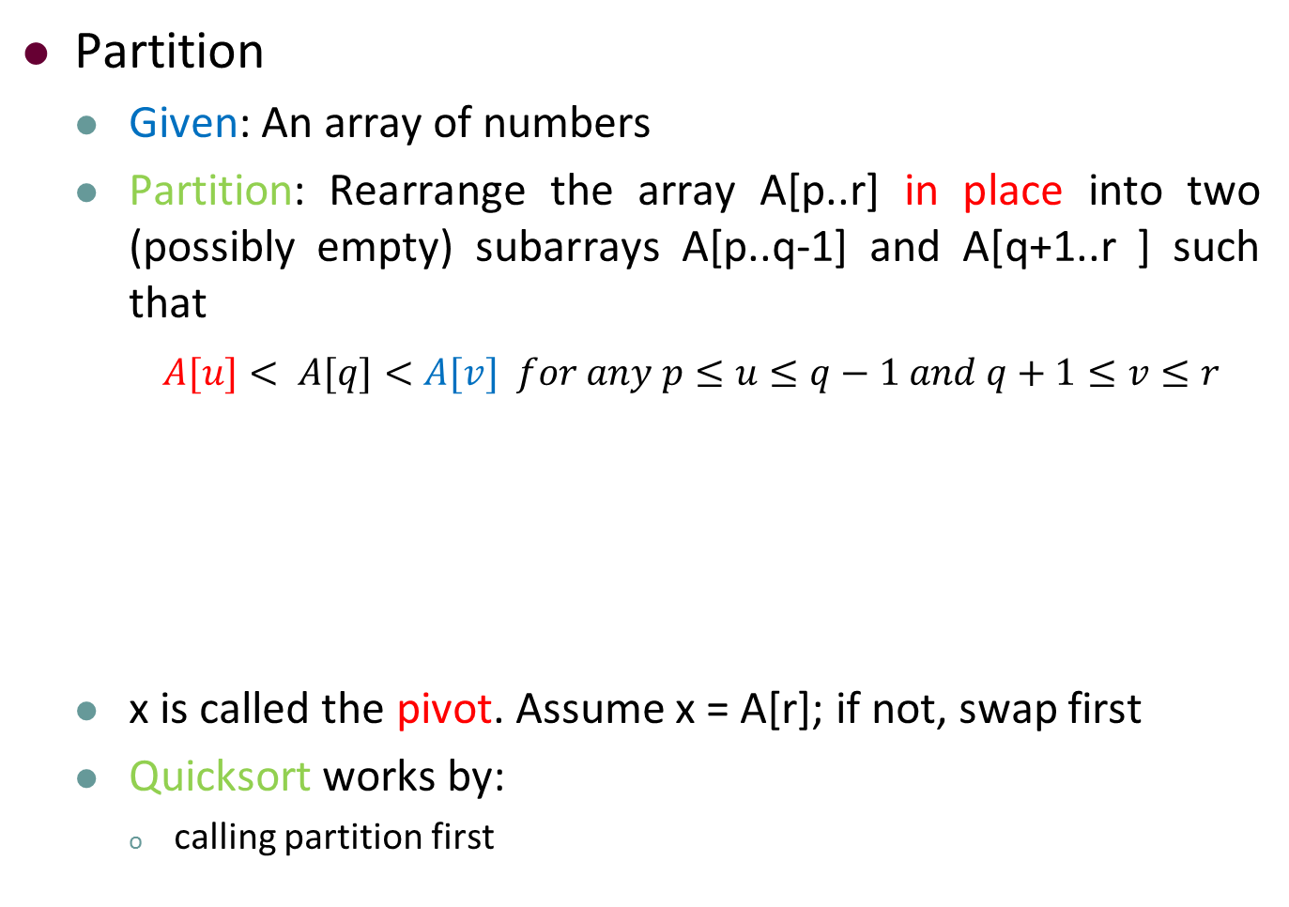
Partition
Partition
Given: An array of numbers
Partition: Rearrange the array A[p..r] in place into two (possibly empty) subarrays A[p..q-1] and A[q+1..r ] such that
$A[u]< A[q]<A[v] for any p≤u≤q−1 and q+1≤v≤r$
x is called the pivot. Assume x = A[r]; if not, swap first
Quicksort works by:
calling partition first

Slide 80
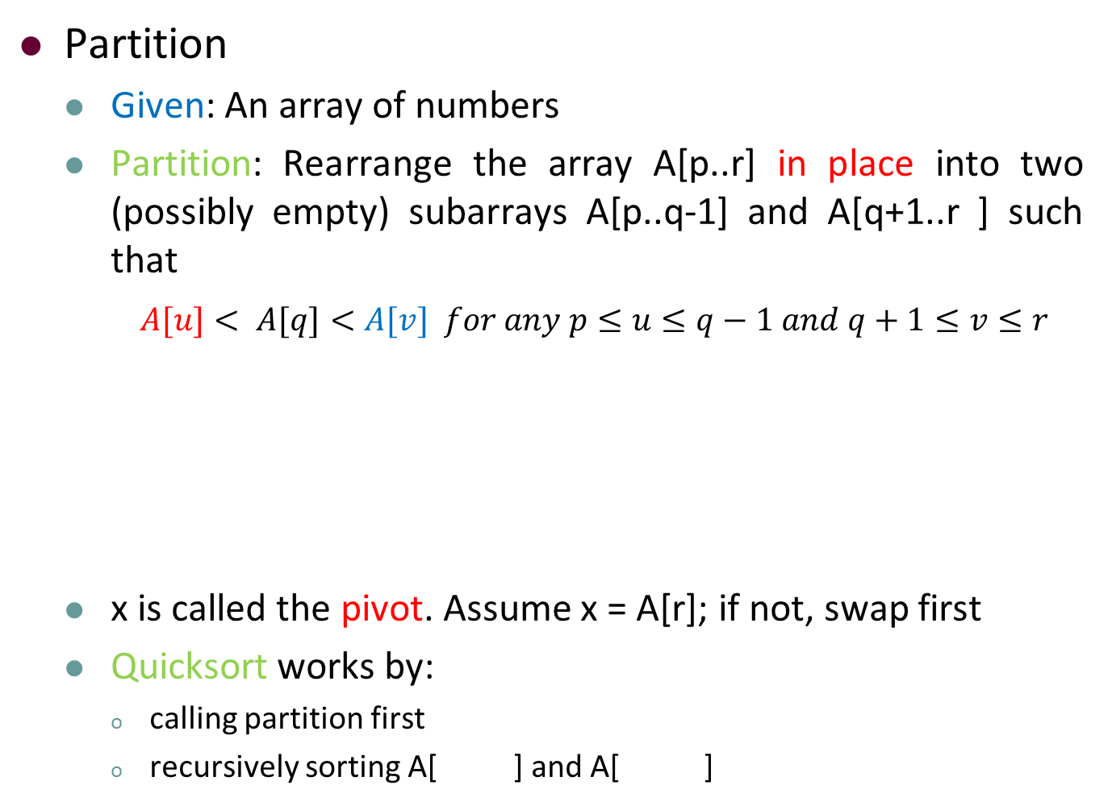
Partition
Partition
Given: An array of numbers
Partition: Rearrange the array A[p..r] in place into two (possibly empty) subarrays A[p..q-1] and A[q+1..r ] such that
$A[u]< A[q]<A[v] for any p≤u≤q−1 and q+1≤v≤r$
x is called the pivot. Assume x = A[r]; if not, swap first
Quicksort works by:
calling partition first
recursively sorting A[ ] and A[ ]

Slide 81

Partition
Partition
Given: An array of numbers
Partition: Rearrange the array A[p..r] in place into two (possibly empty) subarrays A[p..q-1] and A[q+1..r ] such that
$A[u]< A[q]<A[v] for any p≤u≤q−1 and q+1≤v≤r$
x is called the pivot. Assume x = A[r]; if not, swap first
Quicksort works by:
calling partition first
recursively sorting A[p..q-1] and A[ ]

Slide 82

Partition
Partition
Given: An array of numbers
Partition: Rearrange the array A[p..r] in place into two (possibly empty) subarrays A[p..q-1] and A[q+1..r ] such that
$A[u]< A[q]<A[v] for any p≤u≤q−1 and q+1≤v≤r$
x is called the pivot. Assume x = A[r]; if not, swap first
Quicksort works by:
calling partition first
recursively sorting A[p..q-1] and A[q+1..r]

Slide 83
Partition
The idea of Partition(A, p, r)
Use A[r] as the pivot, and grow partition from left to right

Slide 84
Partition
The idea of Partition(A, p, r)
Use A[r] as the pivot, and grow partition from left to right
Initially (i, j) = (p–1, p)
Increase j by 1 each time to find a place for A[j]
At the same time increase i when necessary
Stops when j = r

Slide 85
Partition
One Iteration of the Procedure Partition
Increase j by 1 each time to find a place for A[j]
At the same time increase i when necessary

Slide 86
Partition
One Iteration of the Procedure Partition
Increase j by 1 each time to find a place for A[j]
At the same time increase i when necessary

Slide 87
Partition
One Iteration of the Procedure Partition
Increase j by 1 each time to find a place for A[j]
At the same time increase i when necessary
Case (A): Only increase j by 1

Slide 88
Partition
One Iteration of the Procedure Partition
Increase j by 1 each time to find a place for A[j]
At the same time increase i when necessary
Case (A): Only increase j by 1
Case (B): i = i + 1; A[i] ↔ A[j]; j = j + 1.

Slide 89
Partition-Example
The Operation of Partition(A, p, r)
i
p,j
r
2
8
7
1
3
5
6
4

Slide 90
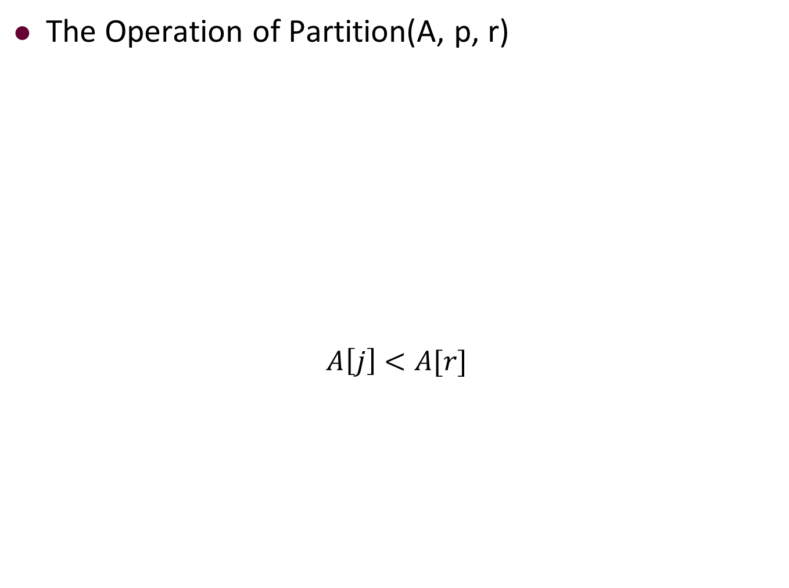
Partition-Example
The Operation of Partition(A, p, r)
$$A\left[j\right]<A[r]$$
i
p,j
r
2
8
7
1
3
5
6
4

Slide 91

Partition-Example
The Operation of Partition(A, p, r)
$$i=i+1,A\left[i\right]↔A\left[j\right],j=j+1$$
p,i
j
r
2
8
7
1
3
5
6
4

Slide 92

Partition-Example
The Operation of Partition(A, p, r)
$$A\left[j\right]>A[r]$$
p,i
j
r
2
8
7
1
3
5
6
4

Slide 93

Partition-Example
The Operation of Partition(A, p, r)
$$Increase j by 1$$
p,i
j
r
2
8
7
1
3
5
6
4

Slide 94
Partition-Example
The Operation of Partition(A, p, r)
$$A\left[j\right]>A[r]$$
p,i
j
r
2
8
7
1
3
5
6
4

Slide 95
Partition-Example
The Operation of Partition(A, p, r)
$$Increase j by 1$$
p,i
j
r
2
8
7
1
3
5
6
4

Slide 96
Partition-Example
The Operation of Partition(A, p, r)
$$A\left[j\right]<A[r]$$
p,i
j
r
2
8
7
1
3
5
6
4

Slide 97
Partition-Example
The Operation of Partition(A, p, r)
$$i=i+1,A\left[i\right]↔A\left[j\right],j=j+1$$
p
i
j
r
2
1
7
8
3
5
6
4

Slide 98
Partition-Example
The Operation of Partition(A, p, r)
$$A\left[j\right]<A[r]$$
p
i
j
r
2
1
7
8
3
5
6
4

Slide 99
Partition-Example
The Operation of Partition(A, p, r)
$$i=i+1,A\left[i\right]↔A\left[j\right],j=j+1$$
p
i
j
r
2
1
3
8
7
5
6
4

Slide 100
Partition-Example
The Operation of Partition(A, p, r)
$$A\left[j\right]>A[r]$$
p
i
j
r
2
1
3
8
7
5
6
4

Slide 101
Partition-Example
The Operation of Partition(A, p, r)
$$Increase j by 1$$
p
i
j
r
2
1
3
8
7
5
6
4

Slide 102
Partition-Example
The Operation of Partition(A, p, r)
$$A\left[j\right]>A[r]$$
p
i
j
r
2
1
3
8
7
5
6
4

Slide 103
Partition-Example
The Operation of Partition(A, p, r)
$$Increase j by 1$$
p
i
j,r
2
1
3
8
7
5
6
4

Slide 104
Partition-Example
The Operation of Partition(A, p, r)
p
i
j,r
2
1
3
8
7
5
6
4

Slide 105

Partition-Example
The Operation of Partition(A, p, r)
$$A[i+1]↔A[r]$$
p
i
j,r
2
1
3
4
7
5
6
8

Slide 106
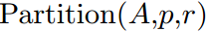
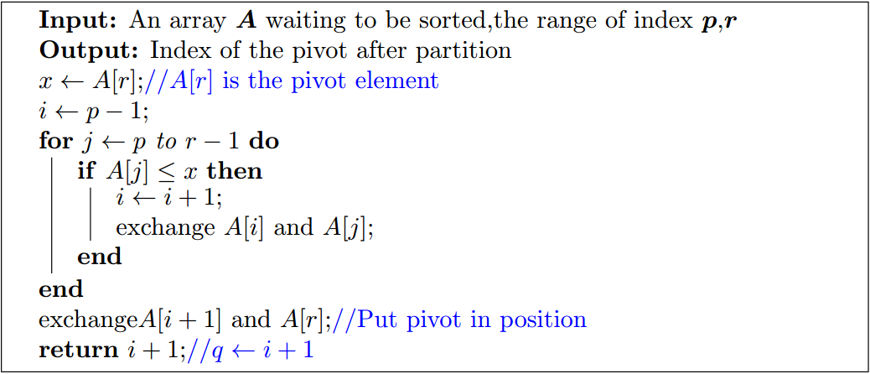
Partition - Pseudocode

Slide 107
Partition - Pseudocode

Slide 108
Partition - Pseudocode

Slide 109
Partition - Pseudocode

Slide 110
Partition - Pseudocode

Slide 111
Partition - Pseudocode

Slide 112
Partition - Pseudocode

Slide 113
Partition - Pseudocode

Slide 114
Partition - Pseudocode
Running time is O( )

Slide 115
Partition - Pseudocode
Running time is O(r – p)

Slide 116
Partition - Pseudocode
Running time is O(r – p)
linear in the length of the array A[p..r]

Slide 117


Quicksort

Slide 118
Quicksort

Slide 119
Quicksort
A Divide-and-Conquer Framework

Slide 120

Quicksort
If we could always partition the array into halves, then we have the recurrence $T(n)≤2T(n/2)+O(n)$, hence $T(n)=O(n log⁡n)$.
A Divide-and-Conquer Framework

Slide 121

Quicksort
If we could always partition the array into halves, then we have the recurrence $T(n)≤2T(n/2)+O(n)$, hence $T(n)=O(n log⁡n)$.
However, if we always get unlucky with very unbalanced partitions, then $T(n)≤T(n−1)+O(n)$, hence $T(n) = O(n2)$.
A Divide-and-Conquer Framework

Slide 122
Outline
Review to Divide-and-Conquer Paradigm
Polynomial Multiplication Problem
Problem definition
A brute force algorithm
A first divide-and-conquer algorithm
An improved divide-and-conquer algorithm
Analysis of the divide-and-conquer algorithm
Quicksort Problem
Basic partition
Randomized partition and randomized quicksort
Analysis of the randomized quicksort

Slide 123
Randomized-Partition(A, p, r)
Idea
In the algorithm Partition(A, p, r), A[r] is always used as the pivot x to partition the array A[p..r].

Slide 124
Randomized-Partition(A, p, r)
Idea
In the algorithm Partition(A, p, r), A[r] is always used as the pivot x to partition the array A[p..r].
In the algorithm Randomized-Partition(A, p, r), we randomly choose an j , p ≤ j ≤ r , and use A[j] as pivot.

Slide 125
Randomized-Partition(A, p, r)
Idea
In the algorithm Partition(A, p, r), A[r] is always used as the pivot x to partition the array A[p..r].
In the algorithm Randomized-Partition(A, p, r), we randomly choose an j , p ≤ j ≤ r , and use A[j] as pivot.
Idea is that if we choose randomly, then the chance that we get unlucky every time is extremely low.

Slide 126
Randomized-Partition(A, p, r)
Pseudocode of Randomized-Partition
Let random(p, r) be a pseudorandom-number generator that returns a random number between p and r.

Slide 127

Randomized-Partition(A, p, r)
Pseudocode of Randomized-Partition
Let random(p, r) be a pseudorandom-number generator that returns a random number between p and r.

Slide 128
Randomized-Partition(A, p, r)
Pseudocode of Randomized-Partition
Let random(p, r) be a pseudorandom-number generator that returns a random number between p and r.

Slide 129
Randomized-Partition(A, p, r)
Pseudocode of Randomized-Partition
Let random(p, r) be a pseudorandom-number generator that returns a random number between p and r.

Slide 130
Randomized-Partition(A, p, r)
Pseudocode of Randomized-Quicksort
We make use of the Randomized-Partition idea to develop a new version of quicksort.

Slide 131

Randomized-Partition(A, p, r)
Pseudocode of Randomized-Quicksort
We make use of the Randomized-Partition idea to develop a new version of quicksort.

Slide 132
Randomized-Partition(A, p, r)
Pseudocode of Randomized-Quicksort
We make use of the Randomized-Partition idea to develop a new version of quicksort.

Slide 133
Randomized-Partition(A, p, r)
Pseudocode of Randomized-Quicksort
We make use of the Randomized-Partition idea to develop a new version of quicksort.

Slide 134
Quicksort - Example
2
8
7
1
3
5
6
4

Slide 135
Quicksort - Example
Divide
2
8
7
1
3
5
6
4

Slide 136
Quicksort - Example
Divide
2
8
7
1
3
5
6
4

Slide 137
Quicksort - Example
Divide
2
8
7
1
3
5
6
4
2
1
3
4
7
5
6
8

Slide 138
Quicksort - Example
Divide
2
8
7
1
3
5
6
4
2
1
3
4
7
5
6
8
2
1
3
4
7
5
6
8

Slide 139
Quicksort - Example
Divide
2
8
7
1
3
5
6
4
2
1
3
4
7
5
6
8
2
1
3
4
7
5
6
8

Slide 140
Quicksort - Example
Divide
2
8
7
1
3
5
6
4
2
1
3
4
7
5
6
8
2
1
3
4
7
5
6
8

Slide 141
Quicksort - Example
Divide
2
8
7
1
3
5
6
4
2
1
3
4
7
5
6
8
2
1
3
4
7
5
6
8
2
1
3

Slide 142
Quicksort - Example
Divide
2
8
7
1
3
5
6
4
2
1
3
4
7
5
6
8
2
1
3
4
7
5
6
8
2
1
3

Slide 143
Quicksort - Example
Divide
2
8
7
1
3
5
6
4
2
1
3
4
7
5
6
8
2
1
3
4
7
5
6
8
2
1
3
5
6
8
7

Slide 144
Quicksort - Example
Divide
2
8
7
1
3
5
6
4
2
1
3
4
7
5
6
8
2
1
3
4
7
5
6
8
2
1
3
4
5
6
8
7

Slide 145
Quicksort - Example
Divide
2
8
7
1
3
5
6
4
2
1
3
4
7
5
6
8
2
1
3
4
7
5
6
8
2
1
3
4
5
6
8
7
2
1
3

Slide 146
Quicksort - Example
Divide
2
8
7
1
3
5
6
4
2
1
3
4
7
5
6
8
2
1
3
4
7
5
6
8
2
1
3
4
5
6
8
7
2
1
3
5
6
8
7

Slide 147
Quicksort - Example
Divide
2
8
7
1
3
5
6
4
2
1
3
4
7
5
6
8
2
1
3
4
7
5
6
8
2
1
3
4
5
6
8
7
2
1
3
4
5
6
8
7

Slide 148
Quicksort - Example
Divide
2
8
7
1
3
5
6
4
2
1
3
4
7
5
6
8
2
1
3
4
7
5
6
8
2
1
3
4
5
6
8
7
2
1
3
4
5
6
8
7

Slide 149
Quicksort - Example
Divide
2
8
7
1
3
5
6
4
2
1
3
4
7
5
6
8
2
1
3
4
7
5
6
8
2
1
3
4
5
6
8
7
2
1
3
4
5
6
8
7

Slide 150
Quicksort - Example
Divide
2
8
7
1
3
5
6
4
2
1
3
4
7
5
6
8
2
1
3
4
7
5
6
8
2
1
3
4
5
6
8
7
2
1
3
4
5
6
8
7
1
2

Slide 151
Quicksort - Example
Divide
2
8
7
1
3
5
6
4
2
1
3
4
7
5
6
8
2
1
3
4
7
5
6
8
2
1
3
4
5
6
8
7
2
1
3
4
5
6
8
7
1
2
3
4

Slide 152
Quicksort - Example
Divide
2
8
7
1
3
5
6
4
2
1
3
4
7
5
6
8
2
1
3
4
7
5
6
8
2
1
3
4
5
6
8
7
2
1
3
4
5
6
8
7
1
2
3
4
5
6

Slide 153
Quicksort - Example
Divide
2
8
7
1
3
5
6
4
2
1
3
4
7
5
6
8
2
1
3
4
7
5
6
8
2
1
3
4
5
6
8
7
2
1
3
4
5
6
8
7
1
2
3
4
5
6

Slide 154
Quicksort - Example
Divide
2
8
7
1
3
5
6
4
2
1
3
4
7
5
6
8
2
1
3
4
7
5
6
8
2
1
3
4
5
6
8
7
2
1
3
4
5
6
8
7
1
2
3
4
5
6
7
8

Slide 155
Quicksort - Example
Divide
2
8
7
1
3
5
6
4
2
1
3
4
7
5
6
8
2
1
3
4
7
5
6
8
2
1
3
4
5
6
8
7
2
1
3
4
5
6
8
7
1
2
3
4
5
6
7
8
1
2

Slide 156
Quicksort - Example
Divide
2
8
7
1
3
5
6
4
2
1
3
4
7
5
6
8
2
1
3
4
7
5
6
8
2
1
3
4
5
6
8
7
2
1
3
4
5
6
8
7
1
2
3
4
5
6
7
8
1
2
7
8

Slide 157
Quicksort - Example
Divide
2
8
7
1
3
5
6
4
2
1
3
4
7
5
6
8
2
1
3
4
7
5
6
8
2
1
3
4
5
6
8
7
2
1
3
4
5
6
8
7
1
2
3
4
5
6
7
8
1
2
3
4
5
6
7
8

Slide 158
Quicksort - Example
Conquer
1
2
3
4
5
6
7
8

Slide 159
Quicksort - Example
Conquer
1
2
3
4
5
6
7
8
1
2

Slide 160
Quicksort - Example
Conquer
1
2
3
4
5
6
7
8
1
2
1
2
3

Slide 161
Quicksort - Example
Conquer
1
2
3
4
5
6
7
8
1
2
7
8
1
2
3

Slide 162
Quicksort - Example
Conquer
1
2
3
4
5
6
7
8
1
2
7
8
1
2
3
5
6
7
8

Slide 163
Quicksort - Example
Conquer
1
2
3
4
5
6
7
8
1
2
7
8
1
2
3
5
6
7
8
1
2
3
4
5
6
7
8

Slide 164
Quicksort - Example
Conquer
1
2
3
4
5
6
7
8
1
2
7
8
1
2
3
5
6
7
8
1
2
3
4
5
6
7
8

Slide 165
Outline
Review to Divide-and-Conquer Paradigm
Polynomial Multiplication Problem
Problem definition
A brute force algorithm
A first divide-and-conquer algorithm
An improved divide-and-conquer algorithm
Analysis of the divide-and-conquer algorithm
Quicksort Problem
Basic partition
Randomized partition and randomized quicksort
Analysis of the randomized quicksort

Slide 166
Running Time of the Quicksort
Measuring running time:

Slide 167
Running Time of the Quicksort
Measuring running time:
The running time is dominated by the time spent in partition.

Slide 168
Running Time of the Quicksort
Measuring running time:
The running time is dominated by the time spent in partition.
The running time of the partition procedure can be measured by the number of key comparisons.

Slide 169

Running Time of the Quicksort
Measuring running time:
The running time is dominated by the time spent in partition.
The running time of the partition procedure can be measured by the number of key comparisons.
T(n): running time on array of size n.
Recurrence: $T(n)=$

Slide 170

Running Time of the Quicksort
Measuring running time:
The running time is dominated by the time spent in partition.
The running time of the partition procedure can be measured by the number of key comparisons.
T(n): running time on array of size n.
Recurrence: $T(n)=T(m)+$

Slide 171

Running Time of the Quicksort
Measuring running time:
The running time is dominated by the time spent in partition.
The running time of the partition procedure can be measured by the number of key comparisons.
T(n): running time on array of size n.
Recurrence: $T(n)=T(m)+T(n−m−1)+$

Slide 172

Running Time of the Quicksort
Measuring running time:
The running time is dominated by the time spent in partition.
The running time of the partition procedure can be measured by the number of key comparisons.
T(n): running time on array of size n.
Recurrence: $T(n)=T(m)+T(n−m−1)+O(n)$

Slide 173

Running Time of the Quicksort
Measuring running time:
The running time is dominated by the time spent in partition.
The running time of the partition procedure can be measured by the number of key comparisons.
T(n): running time on array of size n.
Recurrence: $T(n)=T(m)+T(n−m−1)+O(n)$
Worst Case:

Slide 174

Running Time of the Quicksort
Measuring running time:
The running time is dominated by the time spent in partition.
The running time of the partition procedure can be measured by the number of key comparisons.
T(n): running time on array of size n.
Recurrence: $T(n)=T(m)+T(n−m−1)+O(n)$
Worst Case:
$$T(n) = T(0) + T(n−1) + O(n)$$
$$T(n)= O(n^{2})$$

Slide 175

Running Time of the Quicksort
Measuring running time:
The running time is dominated by the time spent in partition.
The running time of the partition procedure can be measured by the number of key comparisons.
T(n): running time on array of size n.
Recurrence: $T(n)=T(m)+T(n−m−1)+O(n)$
Worst Case:
$$T(n) = T(0) + T(n−1) + O(n)$$
$$T(n)= O(n^{2})$$

Slide 176
Running Time of the Quicksort
Measuring running time:
The running time is dominated by the time spent in partition.
The running time of the partition procedure can be measured by the number of key comparisons.
T(n): running time on array of size n.
Recurrence: $T(n)=T(m)+T(n−m−1)+O(n)$
Worst Case:
$$T(n) = T(0) + T(n−1) + O(n)$$
$$T(n)= O(n^{2})$$

Slide 177

Running Time of the Quicksort
Measuring running time:
The running time is dominated by the time spent in partition.
The running time of the partition procedure can be measured by the number of key comparisons.
T(n): running time on array of size n.
Recurrence: $T(n)=T(m)+T(n−m−1)+O(n)$
Worst Case:
$$T(n) = T(0) + T(n−1) + O(n)$$
$$T(n)= O(n^{2})$$
What inputs give worst case performance?

Slide 178

Running Time of the Quicksort
Measuring running time:
The running time is dominated by the time spent in partition.
The running time of the partition procedure can be measured by the number of key comparisons.
T(n): running time on array of size n.
Recurrence: $T(n)=T(m)+T(n−m−1)+O(n)$
Worst Case:
$$T(n) = T(0) + T(n−1) + O(n)$$
$$T(n)= O(n^{2})$$
What inputs give worst case performance?
Whether performance is the worst is not determined by input.

Slide 179

Running Time of the Quicksort
Measuring running time:
The running time is dominated by the time spent in partition.
The running time of the partition procedure can be measured by the number of key comparisons.
T(n): running time on array of size n.
Recurrence: $T(n)=T(m)+T(n−m−1)+O(n)$
Worst Case:
$$T(n) = T(0) + T(n−1) + O(n)$$
$$T(n)= O(n^{2})$$
What inputs give worst case performance?
Whether performance is the worst is not determined by input.
An important property of randomized algorithms.

Slide 180

Running Time of the Quicksort
Measuring running time:
The running time is dominated by the time spent in partition.
The running time of the partition procedure can be measured by the number of key comparisons.
T(n): running time on array of size n.
Recurrence: $T(n)=T(m)+T(n−m−1)+O(n)$
Worst Case:
$$T(n) = T(0) + T(n−1) + O(n)$$
$$T(n)= O(n^{2})$$
What inputs give worst case performance?
Whether performance is the worst is not determined by input.
An important property of randomized algorithms.
Worst case performance results only if the random number generator always produces the worst choice.

Slide 181
Randomized Algorithms
Analysis for Randomized Algorithms:
Worst-case doesn't make sense: for any given input, the worst case is very unlikely to happen.

Slide 182
Randomized Algorithms
Analysis for Randomized Algorithms:
Worst-case doesn't make sense: for any given input, the worst case is very unlikely to happen.
Use expected running time analysis for randomized algorithms!

Slide 183
Randomized Algorithms
Analysis for Randomized Algorithms:
Worst-case doesn't make sense: for any given input, the worst case is very unlikely to happen.
Use expected running time analysis for randomized algorithms!

Slide 184
Randomized Algorithms
Analysis for Randomized Algorithms:
Worst-case doesn't make sense: for any given input, the worst case is very unlikely to happen.
Use expected running time analysis for randomized algorithms!

Slide 185
Randomized Algorithms
Analysis for Randomized Algorithms:
Worst-case doesn't make sense: for any given input, the worst case is very unlikely to happen.
Use expected running time analysis for randomized algorithms!

Slide 186
Randomized Algorithms
Analysis for Randomized Algorithms:
Worst-case doesn't make sense: for any given input, the worst case is very unlikely to happen.
Use expected running time analysis for randomized algorithms!

Slide 187
Expected Case
Two methods to analyze the expected running time of a divide-and-conquer randomized algorithm:
Old fashioned: Write our a recurrence on T(n), where T(n) is the expected running time of the algorithm on an input of size n, and solve it. —— (Almost) always works but needs complicated maths.

Slide 188
Expected Case
Two methods to analyze the expected running time of a divide-and-conquer randomized algorithm:
Old fashioned: Write our a recurrence on T(n), where T(n) is the expected running time of the algorithm on an input of size n, and solve it. —— (Almost) always works but needs complicated maths.
New: Indicator variables. —— Simple and elegant, but needs practice to master.

Slide 189
Expected Case
Two facts about key comparisons:

Slide 190
Expected Case
Two facts about key comparisons:
When a pivot is selected, the pivot is compared with every other elements, then the elements are partitioned into two parts accordingly

Slide 191
Expected Case
Two facts about key comparisons:
When a pivot is selected, the pivot is compared with every other elements, then the elements are partitioned into two parts accordingly
Elements in different partitions are never compared with each other in all operations

Slide 192
Expected Case

Slide 193
Expected Running Time
Expected Running Time of Randomized-Quicksort:
Let $z_{1} <z_{2}<…<z_{n}$ be the n elements in sorted order

Slide 194
Expected Running Time
Expected Running Time of Randomized-Quicksort:
Let $z_{1} <z_{2}<…<z_{n}$ be the n elements in sorted order
X: total number of comparisons performed in all calls to randomized-partition

Slide 195
Expected Running Time
Expected Running Time of Randomized-Quicksort:
Let $z_{1} <z_{2}<…<z_{n}$ be the n elements in sorted order
X: total number of comparisons performed in all calls to randomized-partition
X_{ij} : number of comparisons between z_{i} and z_{j}

Slide 196
Expected Running Time
Expected Running Time of Randomized-Quicksort:
Let $z_{1} <z_{2}<…<z_{n}$ be the n elements in sorted order
X: total number of comparisons performed in all calls to randomized-partition
X_{ij} : number of comparisons between z_{i} and z_{j}
can only be 0 or 1

Slide 197

Expected Running Time
Expected Running Time of Randomized-Quicksort:
Let $z_{1} <z_{2}<…<z_{n}$ be the n elements in sorted order
X: total number of comparisons performed in all calls to randomized-partition
X_{ij} : number of comparisons between z_{i} and z_{j}
can only be 0 or 1
$$E\left[X\right]=E\left[\sum_{i=1}^{n−1}{\sum_{j=i+1}^{n}{X_{ij}}}\right]=\sum_{i=1}^{n−1}{\sum_{j=i+1}^{n}{E[X_{ij}]}} \\ =\sum_{i=1}^{n−1}{\sum_{j=i+1}^{n}{[\operatorname{Pr}\left\{z_{i} is compared with z_{j}\right\}×1}} \\ +\operatorname{Pr}\left\{z_{i} is not compared with z_{j}\right\}×0] \\ =\sum_{i=1}^{n−1}{\sum_{j=i+1}^{n}{\operatorname{Pr}\left\{z_{i} is compared with z_{j}\right\}}}$$

Slide 198
Expected Running Time
Expected Running Time of Randomized-Quicksort:
Let $z_{1} <z_{2}<…<z_{n}$ be the n elements in sorted order
X: total number of comparisons performed in all calls to randomized-partition
X_{ij} : number of comparisons between z_{i} and z_{j}
can only be 0 or 1
$$E\left[X\right]=E\left[\sum_{i=1}^{n−1}{\sum_{j=i+1}^{n}{X_{ij}}}\right]=\sum_{i=1}^{n−1}{\sum_{j=i+1}^{n}{E[X_{ij}]}} \\ =\sum_{i=1}^{n−1}{\sum_{j=i+1}^{n}{[\operatorname{Pr}\left\{z_{i} is compared with z_{j}\right\}×1}} \\ +\operatorname{Pr}\left\{z_{i} is not compared with z_{j}\right\}×0] \\ =\sum_{i=1}^{n−1}{\sum_{j=i+1}^{n}{\operatorname{Pr}\left\{z_{i} is compared with z_{j}\right\}}}$$

Slide 199
Expected Running Time
Expected Running Time of Randomized-Quicksort:
Let $z_{1} <z_{2}<…<z_{n}$ be the n elements in sorted order
X: total number of comparisons performed in all calls to randomized-partition
X_{ij} : number of comparisons between z_{i} and z_{j}
can only be 0 or 1
$$E\left[X\right]=E\left[\sum_{i=1}^{n−1}{\sum_{j=i+1}^{n}{X_{ij}}}\right]=\sum_{i=1}^{n−1}{\sum_{j=i+1}^{n}{E[X_{ij}]}} \\ =\sum_{i=1}^{n−1}{\sum_{j=i+1}^{n}{[\operatorname{Pr}\left\{z_{i} is compared with z_{j}\right\}×1}} \\ +\operatorname{Pr}\left\{z_{i} is not compared with z_{j}\right\}×0] \\ =\sum_{i=1}^{n−1}{\sum_{j=i+1}^{n}{\operatorname{Pr}\left\{z_{i} is compared with z_{j}\right\}}}$$

Slide 200
Expected Running Time
Expected Running Time of Randomized-Quicksort:
Let $z_{1} <z_{2}<…<z_{n}$ be the n elements in sorted order
X: total number of comparisons performed in all calls to randomized-partition
X_{ij} : number of comparisons between z_{i} and z_{j}
can only be 0 or 1
$$E\left[X\right]=E\left[\sum_{i=1}^{n−1}{\sum_{j=i+1}^{n}{X_{ij}}}\right]=\sum_{i=1}^{n−1}{\sum_{j=i+1}^{n}{E[X_{ij}]}} \\ =\sum_{i=1}^{n−1}{\sum_{j=i+1}^{n}{[\operatorname{Pr}\left\{z_{i} is compared with z_{j}\right\}×1}} \\ +\operatorname{Pr}\left\{z_{i} is not compared with z_{j}\right\}×0] \\ =\sum_{i=1}^{n−1}{\sum_{j=i+1}^{n}{\operatorname{Pr}\left\{z_{i} is compared with z_{j}\right\}}}$$

Slide 201
Expected Running Time
Expected Running Time of Randomized-Quicksort:
Let $z_{1} <z_{2}<…<z_{n}$ be the n elements in sorted order
X: total number of comparisons performed in all calls to randomized-partition
X_{ij} : number of comparisons between z_{i} and z_{j}
can only be 0 or 1
$$E\left[X\right]=E\left[\sum_{i=1}^{n−1}{\sum_{j=i+1}^{n}{X_{ij}}}\right]=\sum_{i=1}^{n−1}{\sum_{j=i+1}^{n}{E[X_{ij}]}} \\ =\sum_{i=1}^{n−1}{\sum_{j=i+1}^{n}{[\operatorname{Pr}\left\{z_{i} is compared with z_{j}\right\}×1}} \\ +\operatorname{Pr}\left\{z_{i} is not compared with z_{j}\right\}×0] \\ =\sum_{i=1}^{n−1}{\sum_{j=i+1}^{n}{\operatorname{Pr}\left\{z_{i} is compared with z_{j}\right\}}}$$

Slide 202
Expected Running Time
Expected Running Time of Randomized-Quicksort:
Let $z_{1} <z_{2}<…<z_{n}$ be the n elements in sorted order
X: total number of comparisons performed in all calls to randomized-partition
X_{ij} : number of comparisons between z_{i} and z_{j}
can only be 0 or 1
$$E\left[X\right]=E\left[\sum_{i=1}^{n−1}{\sum_{j=i+1}^{n}{X_{ij}}}\right]=\sum_{i=1}^{n−1}{\sum_{j=i+1}^{n}{E[X_{ij}]}} \\ =\sum_{i=1}^{n−1}{\sum_{j=i+1}^{n}{[\operatorname{Pr}\left\{z_{i} is compared with z_{j}\right\}×1}} \\ +\operatorname{Pr}\left\{z_{i} is not compared with z_{j}\right\}×0] \\ =\sum_{i=1}^{n−1}{\sum_{j=i+1}^{n}{\operatorname{Pr}\left\{z_{i} is compared with z_{j}\right\}}}$$

Slide 203
Expected Running Time
Expected Running Time of Randomized-Quicksort:
Let $z_{1} <z_{2}<…<z_{n}$ be the n elements in sorted order
X: total number of comparisons performed in all calls to randomized-partition
X_{ij} : number of comparisons between z_{i} and z_{j}
can only be 0 or 1
$$E\left[X\right]=E\left[\sum_{i=1}^{n−1}{\sum_{j=i+1}^{n}{X_{ij}}}\right]=\sum_{i=1}^{n−1}{\sum_{j=i+1}^{n}{E[X_{ij}]}} \\ =\sum_{i=1}^{n−1}{\sum_{j=i+1}^{n}{[\operatorname{Pr}\left\{z_{i} is compared with z_{j}\right\}×1}} \\ +\operatorname{Pr}\left\{z_{i} is not compared with z_{j}\right\}×0] \\ =\sum_{i=1}^{n−1}{\sum_{j=i+1}^{n}{\operatorname{Pr}\left\{z_{i} is compared with z_{j}\right\}}}$$

Slide 204

Observations
For $1≤i≤j≤n$, let $Z_{ij}=\{z_{i} , z_{i+1},…, z_{j}\}$
remember $z_{i}<z_{i+1}<…< z_{j}$

Slide 205

Observations
For $1≤i≤j≤n$, let $Z_{ij}=\{z_{i} , z_{i+1},…, z_{j}\}$
remember $z_{i}<z_{i+1}<…< z_{j}$
Observations:
Partition divides an array into three segments, left, pivot, and Right.
When z_{i} and z_{j} are first placed in DIFFERENT segments of the array by partitioning, the pivot is one of the elements in Z_{ij}

Slide 206

Observations
For $1≤i≤j≤n$, let $Z_{ij}=\{z_{i} , z_{i+1},…, z_{j}\}$
remember $z_{i}<z_{i+1}<…< z_{j}$
Observations:
Partition divides an array into three segments, left, pivot, and Right.
When z_{i} and z_{j} are first placed in DIFFERENT segments of the array by partitioning, the pivot is one of the elements in Z_{ij}
If the pivot is either z_{i} or z_{j}

Slide 207

Observations
For $1≤i≤j≤n$, let $Z_{ij}=\{z_{i} , z_{i+1},…, z_{j}\}$
remember $z_{i}<z_{i+1}<…< z_{j}$
Observations:
Partition divides an array into three segments, left, pivot, and Right.
When z_{i} and z_{j} are first placed in DIFFERENT segments of the array by partitioning, the pivot is one of the elements in Z_{ij}
If the pivot is either z_{i} or z_{j}
z_{i} and z_{j} will be compared

Slide 208

Observations
For $1≤i≤j≤n$, let $Z_{ij}=\{z_{i} , z_{i+1},…, z_{j}\}$
remember $z_{i}<z_{i+1}<…< z_{j}$
Observations:
Partition divides an array into three segments, left, pivot, and Right.
When z_{i} and z_{j} are first placed in DIFFERENT segments of the array by partitioning, the pivot is one of the elements in Z_{ij}
If the pivot is either z_{i} or z_{j}
z_{i} and z_{j} will be compared
If the pivot is any element in Z_{ij} other than z_{i} or z_{j}
z_{i} and z_{j} are not compared with each other in all randomized-partition calls

Slide 209
How to Find $Pr\{z_{i} is compared with z_{j}\}$?
$$\operatorname{Pr}\left\{z_{i} is compared with z_{j}\right\} \\ =\operatorname{Pr}\left\{z_{i} or z_{j} is the first pivot chosen from Z_{ij}\right\} \\ =\operatorname{Pr}\left\{z_{i} is the first pivot chosen from Z_{ij}\right\} \\ +\operatorname{Pr}\left\{z_{j} is the first pivot chosen from Z_{ij}\right\} \\ =\frac{1}{j−i+1}+\frac{1}{j−i+1 }=\frac{2}{j−i+1}$$

Slide 210
How to Find $Pr\{z_{i} is compared with z_{j}\}$?
$$\operatorname{Pr}\left\{z_{i} is compared with z_{j}\right\} \\ =\operatorname{Pr}\left\{z_{i} or z_{j} is the first pivot chosen from Z_{ij}\right\} \\ =\operatorname{Pr}\left\{z_{i} is the first pivot chosen from Z_{ij}\right\} \\ +\operatorname{Pr}\left\{z_{j} is the first pivot chosen from Z_{ij}\right\} \\ =\frac{1}{j−i+1}+\frac{1}{j−i+1 }=\frac{2}{j−i+1}$$

Slide 211
How to Find $Pr\{z_{i} is compared with z_{j}\}$?
$$\operatorname{Pr}\left\{z_{i} is compared with z_{j}\right\} \\ =\operatorname{Pr}\left\{z_{i} or z_{j} is the first pivot chosen from Z_{ij}\right\} \\ =\operatorname{Pr}\left\{z_{i} is the first pivot chosen from Z_{ij}\right\} \\ +\operatorname{Pr}\left\{z_{j} is the first pivot chosen from Z_{ij}\right\} \\ =\frac{1}{j−i+1}+\frac{1}{j−i+1 }=\frac{2}{j−i+1}$$

Slide 212
How to Find $Pr\{z_{i} is compared with z_{j}\}$?
$$\operatorname{Pr}\left\{z_{i} is compared with z_{j}\right\} \\ =\operatorname{Pr}\left\{z_{i} or z_{j} is the first pivot chosen from Z_{ij}\right\} \\ =\operatorname{Pr}\left\{z_{i} is the first pivot chosen from Z_{ij}\right\} \\ +\operatorname{Pr}\left\{z_{j} is the first pivot chosen from Z_{ij}\right\} \\ =\frac{1}{j−i+1}+\frac{1}{j−i+1 }=\frac{2}{j−i+1}$$

Slide 213
How to Find $Pr\{z_{i} is compared with z_{j}\}$?
$$\operatorname{Pr}\left\{z_{i} is compared with z_{j}\right\} \\ =\operatorname{Pr}\left\{z_{i} or z_{j} is the first pivot chosen from Z_{ij}\right\} \\ =\operatorname{Pr}\left\{z_{i} is the first pivot chosen from Z_{ij}\right\} \\ +\operatorname{Pr}\left\{z_{j} is the first pivot chosen from Z_{ij}\right\} \\ =\frac{1}{j−i+1}+\frac{1}{j−i+1 }=\frac{2}{j−i+1}$$

Slide 214
How to Find $Pr\{z_{i} is compared with z_{j}\}$?
$$\operatorname{Pr}\left\{z_{i} is compared with z_{j}\right\} \\ =\operatorname{Pr}\left\{z_{i} or z_{j} is the first pivot chosen from Z_{ij}\right\} \\ =\operatorname{Pr}\left\{z_{i} is the first pivot chosen from Z_{ij}\right\} \\ +\operatorname{Pr}\left\{z_{j} is the first pivot chosen from Z_{ij}\right\} \\ =\frac{1}{j−i+1}+\frac{1}{j−i+1 }=\frac{2}{j−i+1}$$

Slide 215
How to Find $Pr\{z_{i} is compared with z_{j}\}$?
$$\operatorname{Pr}\left\{z_{i} is compared with z_{j}\right\} \\ =\operatorname{Pr}\left\{z_{i} or z_{j} is the first pivot chosen from Z_{ij}\right\} \\ =\operatorname{Pr}\left\{z_{i} is the first pivot chosen from Z_{ij}\right\} \\ +\operatorname{Pr}\left\{z_{j} is the first pivot chosen from Z_{ij}\right\} \\ =\frac{1}{j−i+1}+\frac{1}{j−i+1 }=\frac{2}{j−i+1}$$
$$E\left[X\right]=\sum_{i=1}^{n−1}{\sum_{j=i+1}^{n}{\operatorname{Pr}\left\{z_{i} is compared with z_{j}\right\}=}}\sum_{i=1}^{n−1}{\sum_{j=i+1}^{n}{\frac{2}{j−i+1}}} \\ =\sum_{i=1}^{n−1}{\sum_{k=1}^{n−i}{\frac{2}{k+1}}}<\sum_{i=1}^{n−1}{\sum_{k=1}^{n}{\frac{2}{k}}}=\sum_{i=1}^{n−1}{O(\log{n})}=O(n\log{n})$$

Slide 216
How to Find $Pr\{z_{i} is compared with z_{j}\}$?
$$\operatorname{Pr}\left\{z_{i} is compared with z_{j}\right\} \\ =\operatorname{Pr}\left\{z_{i} or z_{j} is the first pivot chosen from Z_{ij}\right\} \\ =\operatorname{Pr}\left\{z_{i} is the first pivot chosen from Z_{ij}\right\} \\ +\operatorname{Pr}\left\{z_{j} is the first pivot chosen from Z_{ij}\right\} \\ =\frac{1}{j−i+1}+\frac{1}{j−i+1 }=\frac{2}{j−i+1}$$
$$E\left[X\right]=\sum_{i=1}^{n−1}{\sum_{j=i+1}^{n}{\operatorname{Pr}\left\{z_{i} is compared with z_{j}\right\}=}}\sum_{i=1}^{n−1}{\sum_{j=i+1}^{n}{\frac{2}{j−i+1}}} \\ =\sum_{i=1}^{n−1}{\sum_{k=1}^{n−i}{\frac{2}{k+1}}}<\sum_{i=1}^{n−1}{\sum_{k=1}^{n}{\frac{2}{k}}}=\sum_{i=1}^{n−1}{O(\log{n})}=O(n\log{n})$$

Slide 217
How to Find $Pr\{z_{i} is compared with z_{j}\}$?
$$\operatorname{Pr}\left\{z_{i} is compared with z_{j}\right\} \\ =\operatorname{Pr}\left\{z_{i} or z_{j} is the first pivot chosen from Z_{ij}\right\} \\ =\operatorname{Pr}\left\{z_{i} is the first pivot chosen from Z_{ij}\right\} \\ +\operatorname{Pr}\left\{z_{j} is the first pivot chosen from Z_{ij}\right\} \\ =\frac{1}{j−i+1}+\frac{1}{j−i+1 }=\frac{2}{j−i+1}$$
$$E\left[X\right]=\sum_{i=1}^{n−1}{\sum_{j=i+1}^{n}{\operatorname{Pr}\left\{z_{i} is compared with z_{j}\right\}=}}\sum_{i=1}^{n−1}{\sum_{j=i+1}^{n}{\frac{2}{j−i+1}}} \\ =\sum_{i=1}^{n−1}{\sum_{k=1}^{n−i}{\frac{2}{k+1}}}<\sum_{i=1}^{n−1}{\sum_{k=1}^{n}{\frac{2}{k}}}=\sum_{i=1}^{n−1}{O(\log{n})}=O(n\log{n})$$

Slide 218
How to Find $Pr\{z_{i} is compared with z_{j}\}$?
$$\operatorname{Pr}\left\{z_{i} is compared with z_{j}\right\} \\ =\operatorname{Pr}\left\{z_{i} or z_{j} is the first pivot chosen from Z_{ij}\right\} \\ =\operatorname{Pr}\left\{z_{i} is the first pivot chosen from Z_{ij}\right\} \\ +\operatorname{Pr}\left\{z_{j} is the first pivot chosen from Z_{ij}\right\} \\ =\frac{1}{j−i+1}+\frac{1}{j−i+1 }=\frac{2}{j−i+1}$$
$$E\left[X\right]=\sum_{i=1}^{n−1}{\sum_{j=i+1}^{n}{\operatorname{Pr}\left\{z_{i} is compared with z_{j}\right\}=}}\sum_{i=1}^{n−1}{\sum_{j=i+1}^{n}{\frac{2}{j−i+1}}} \\ =\sum_{i=1}^{n−1}{\sum_{k=1}^{n−i}{\frac{2}{k+1}}}<\sum_{i=1}^{n−1}{\sum_{k=1}^{n}{\frac{2}{k}}}=\sum_{i=1}^{n−1}{O(\log{n})}=O(n\log{n})$$

Slide 219

How to Find $Pr\{z_{i} is compared with z_{j}\}$?
$$\operatorname{Pr}\left\{z_{i} is compared with z_{j}\right\} \\ =\operatorname{Pr}\left\{z_{i} or z_{j} is the first pivot chosen from Z_{ij}\right\} \\ =\operatorname{Pr}\left\{z_{i} is the first pivot chosen from Z_{ij}\right\} \\ +\operatorname{Pr}\left\{z_{j} is the first pivot chosen from Z_{ij}\right\} \\ =\frac{1}{j−i+1}+\frac{1}{j−i+1 }=\frac{2}{j−i+1}$$
$$E\left[X\right]=\sum_{i=1}^{n−1}{\sum_{j=i+1}^{n}{\operatorname{Pr}\left\{z_{i} is compared with z_{j}\right\}=}}\sum_{i=1}^{n−1}{\sum_{j=i+1}^{n}{\frac{2}{j−i+1}}} \\ =\sum_{i=1}^{n−1}{\sum_{k=1}^{n−i}{\frac{2}{k+1}}}<\sum_{i=1}^{n−1}{\sum_{k=1}^{n}{\frac{2}{k}}}=\sum_{i=1}^{n−1}{O(\log{n})}=O(n\log{n})$$
Note: $\sum_{k=1}^{n}{\frac{1}{k}}≤log⁡(n)$

Slide 220
How to Find $Pr\{z_{i} is compared with z_{j}\}$?
$$\operatorname{Pr}\left\{z_{i} is compared with z_{j}\right\} \\ =\operatorname{Pr}\left\{z_{i} or z_{j} is the first pivot chosen from Z_{ij}\right\} \\ =\operatorname{Pr}\left\{z_{i} is the first pivot chosen from Z_{ij}\right\} \\ +\operatorname{Pr}\left\{z_{j} is the first pivot chosen from Z_{ij}\right\} \\ =\frac{1}{j−i+1}+\frac{1}{j−i+1 }=\frac{2}{j−i+1}$$
$$E\left[X\right]=\sum_{i=1}^{n−1}{\sum_{j=i+1}^{n}{\operatorname{Pr}\left\{z_{i} is compared with z_{j}\right\}=}}\sum_{i=1}^{n−1}{\sum_{j=i+1}^{n}{\frac{2}{j−i+1}}} \\ =\sum_{i=1}^{n−1}{\sum_{k=1}^{n−i}{\frac{2}{k+1}}}<\sum_{i=1}^{n−1}{\sum_{k=1}^{n}{\frac{2}{k}}}=\sum_{i=1}^{n−1}{O(\log{n})}=O(n\log{n})$$
Note: $\sum_{k=1}^{n}{\frac{1}{k}}≤log⁡(n)$

Slide 221
How to Find $Pr\{z_{i} is compared with z_{j}\}$?
$$\operatorname{Pr}\left\{z_{i} is compared with z_{j}\right\} \\ =\operatorname{Pr}\left\{z_{i} or z_{j} is the first pivot chosen from Z_{ij}\right\} \\ =\operatorname{Pr}\left\{z_{i} is the first pivot chosen from Z_{ij}\right\} \\ +\operatorname{Pr}\left\{z_{j} is the first pivot chosen from Z_{ij}\right\} \\ =\frac{1}{j−i+1}+\frac{1}{j−i+1 }=\frac{2}{j−i+1}$$
$$E\left[X\right]=\sum_{i=1}^{n−1}{\sum_{j=i+1}^{n}{\operatorname{Pr}\left\{z_{i} is compared with z_{j}\right\}=}}\sum_{i=1}^{n−1}{\sum_{j=i+1}^{n}{\frac{2}{j−i+1}}} \\ =\sum_{i=1}^{n−1}{\sum_{k=1}^{n−i}{\frac{2}{k+1}}}<\sum_{i=1}^{n−1}{\sum_{k=1}^{n}{\frac{2}{k}}}=\sum_{i=1}^{n−1}{O(\log{n})}=O(n\log{n})$$
Note: $\sum_{k=1}^{n}{\frac{1}{k}}≤log⁡(n)$
Hence, the expected number of comparisons is $O(n log⁡n)$, which is
the expected running time of Randomized-Quicksort

Slide 222


